Slide 1


Slide 2
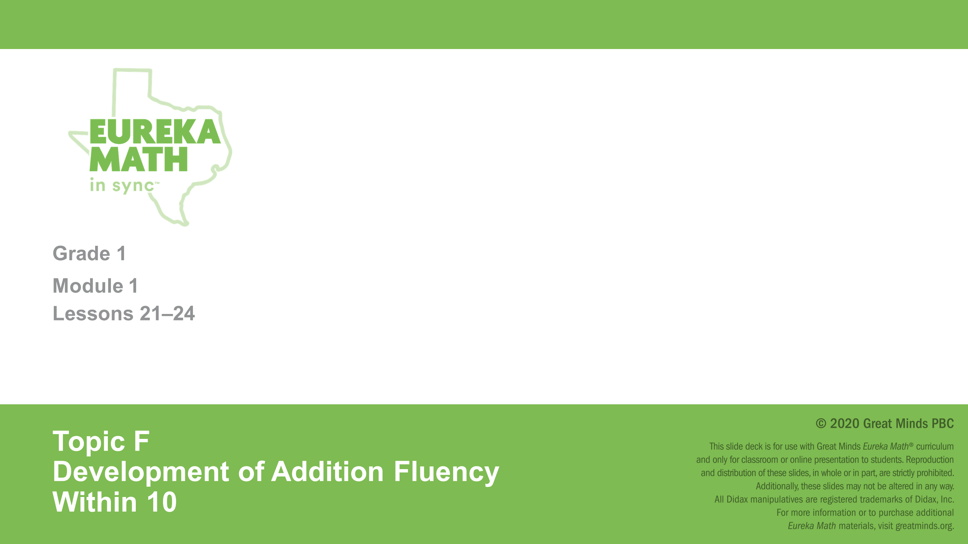

Slide 3


Slide 4
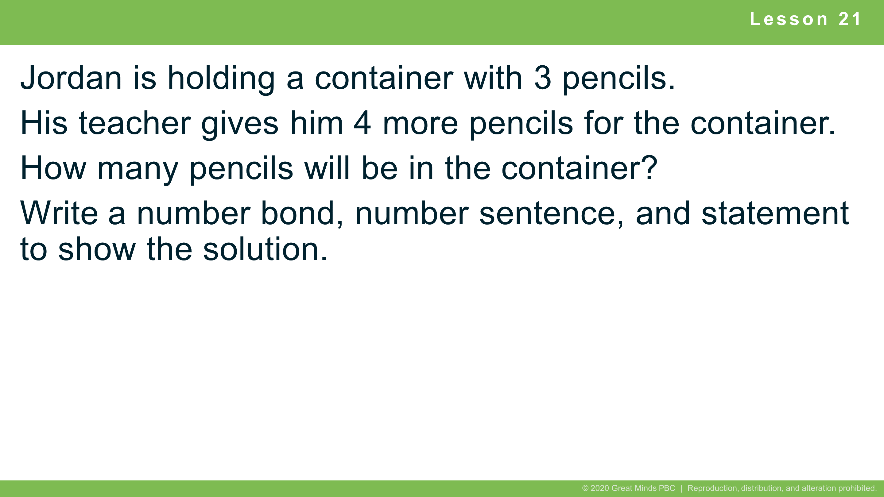
Notes:
Lesson 21
5 minutes
Independent Practice
Note: This Application Problem uses the commutative property to count on from the larger addend from Lesson 20. It is also relevant to the Concept Development of the current lesson as a doubles plus 1 problem.

Slide 5
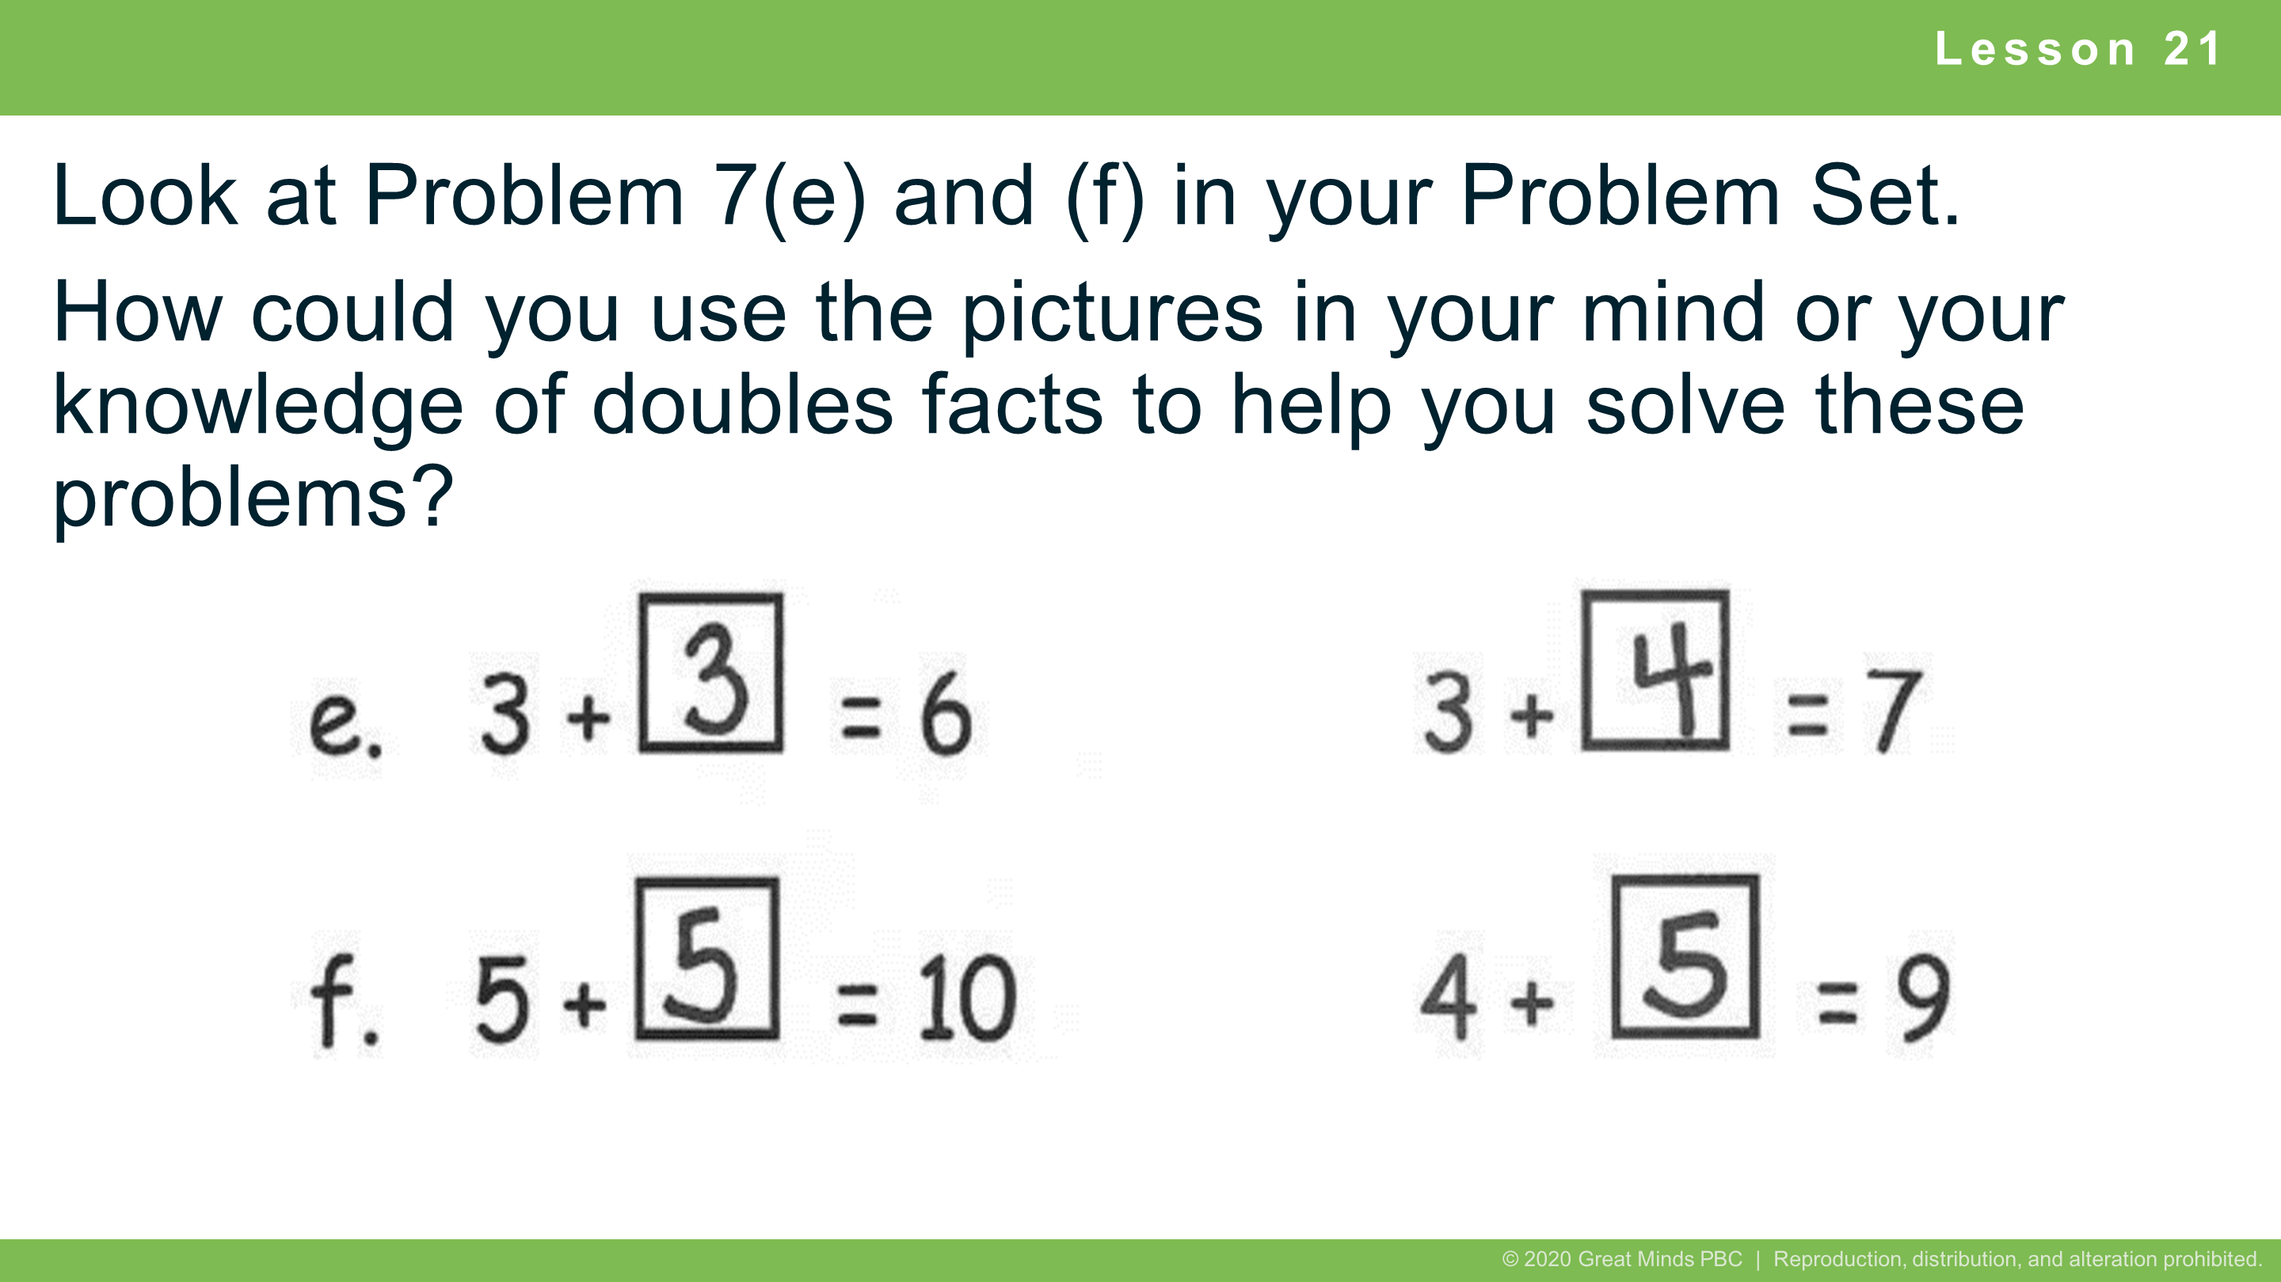
Notes:
Lesson 21
Student Debrief: Connection
Look at Problem 7(e) and (f) in your Problem Set. How could you use the pictures in your mind or your knowledge of doubles facts to help you solve these problems?

Slide 6


Slide 7
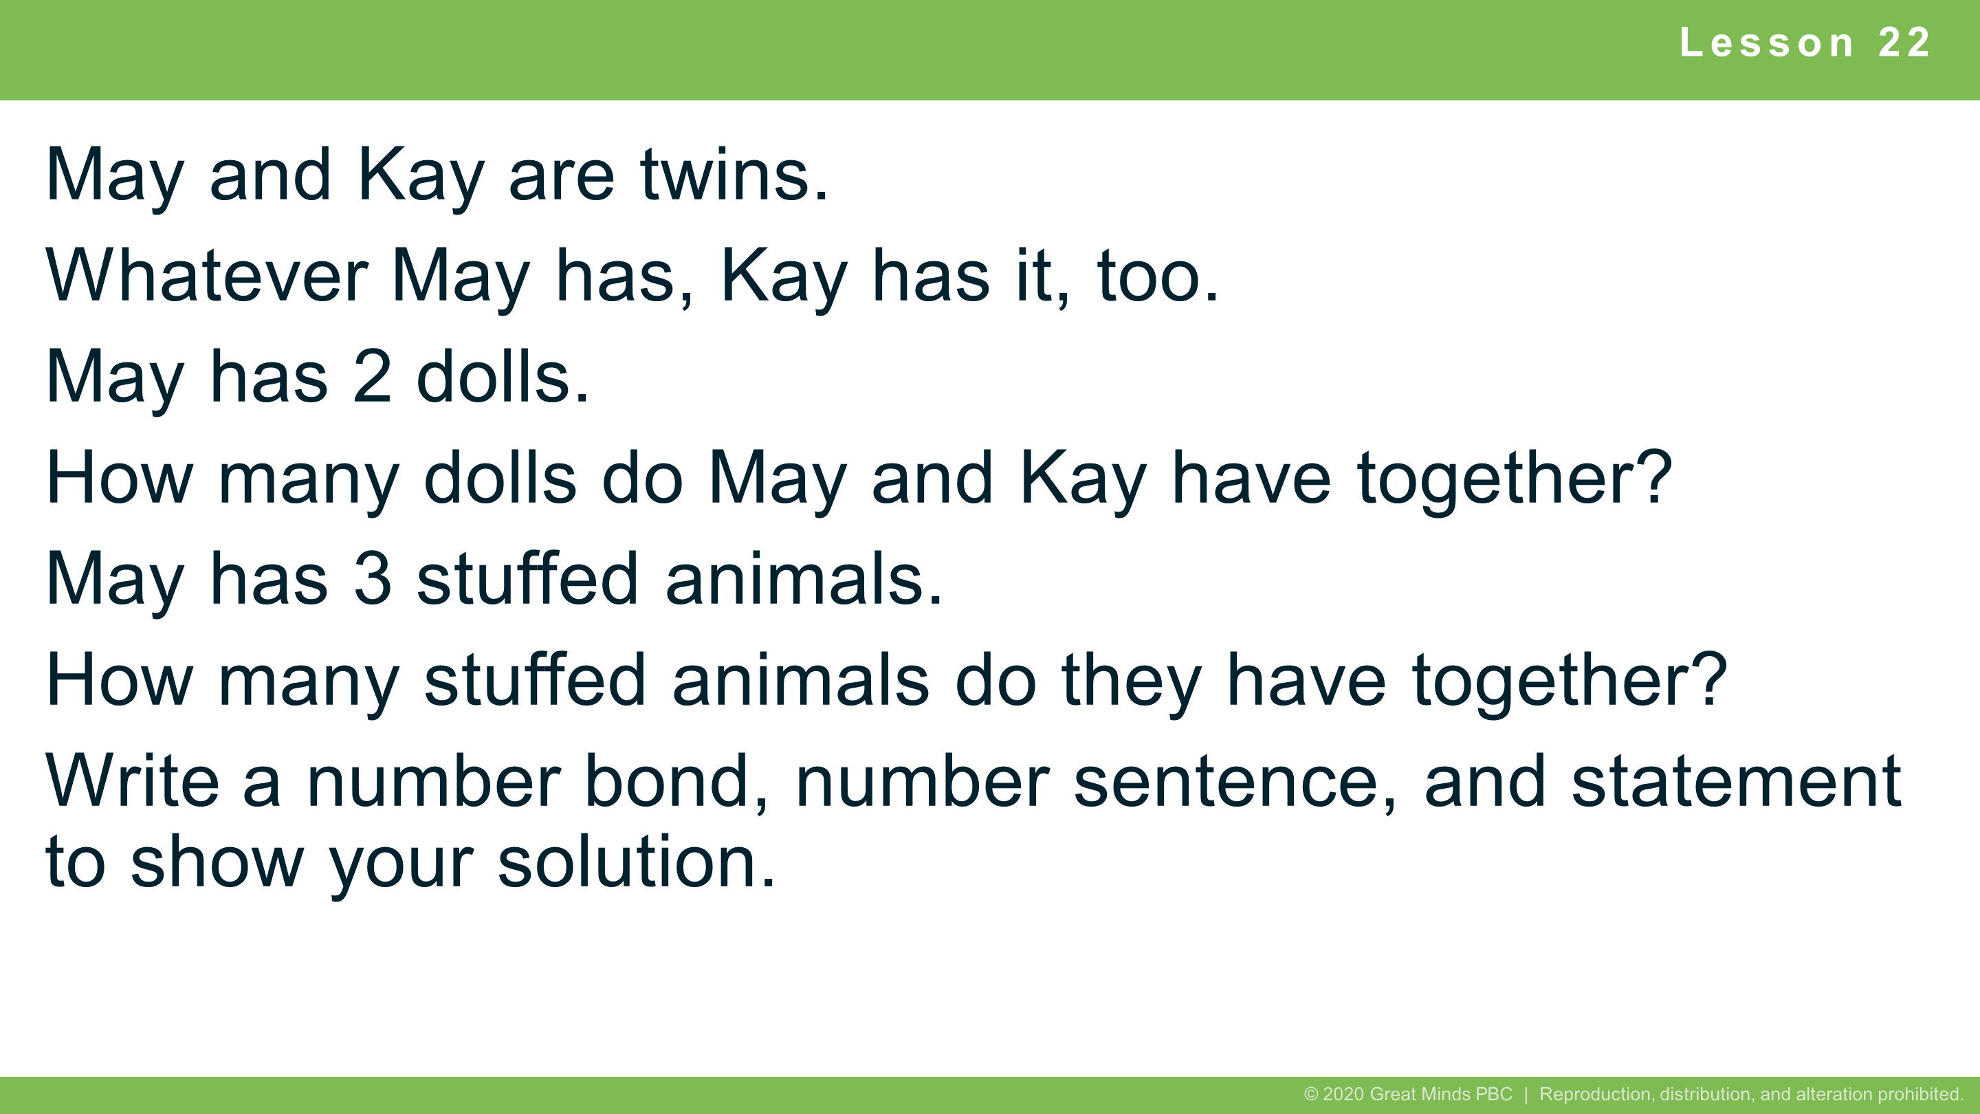
Notes:
Lesson 22
5 minutes
Guided Practice
Extension: If all the dolls and all the stuffed animals were put together for an imaginary tea party, how many toys would there be? Draw or write to explain your thinking.
Note: This Application Problem is designed as a bridge from the previous lesson, which focused on doubles. Students will also have the opportunity to locate the expressions within their number sentences on the chart and begin to recognize other ways to use repeated reasoning as they explore the addition chart. Teachers may want to take note of students who are using finger counting for doubles. This may help identify students who require additional time or support to utilize doubles as a strategy.

Slide 8
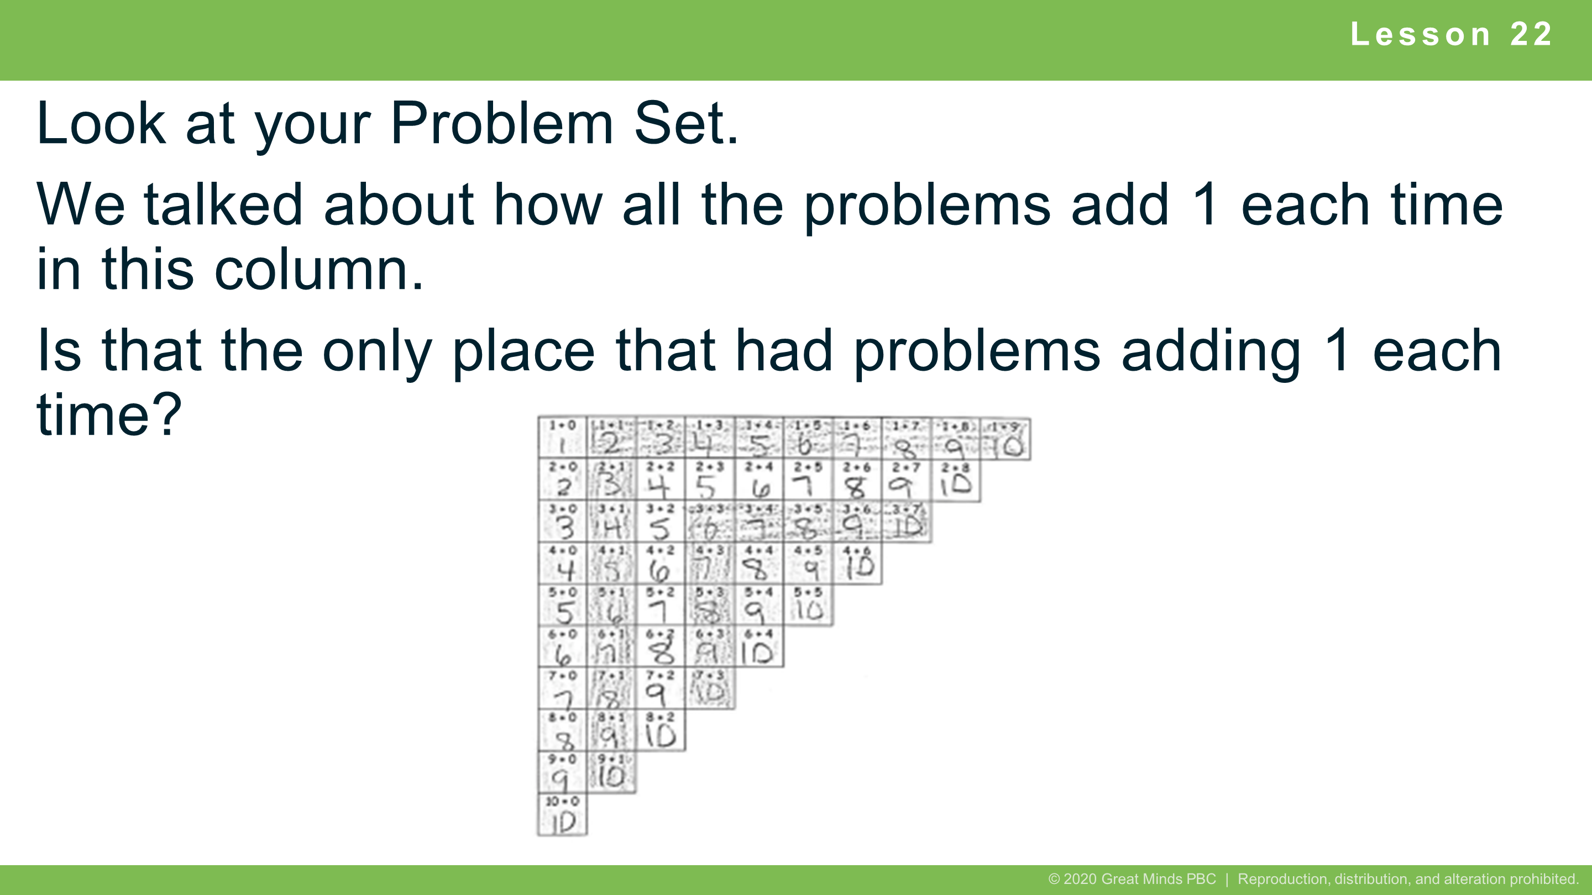
Notes:
Lesson 22
Student Debrief: Connection
Look at your Problem Set. We talked about how all the problems add 1 each time in this column. (Gesture going up and down on +1 column.) Is that the only place that had problems adding 1 each time?

Slide 9


Slide 10
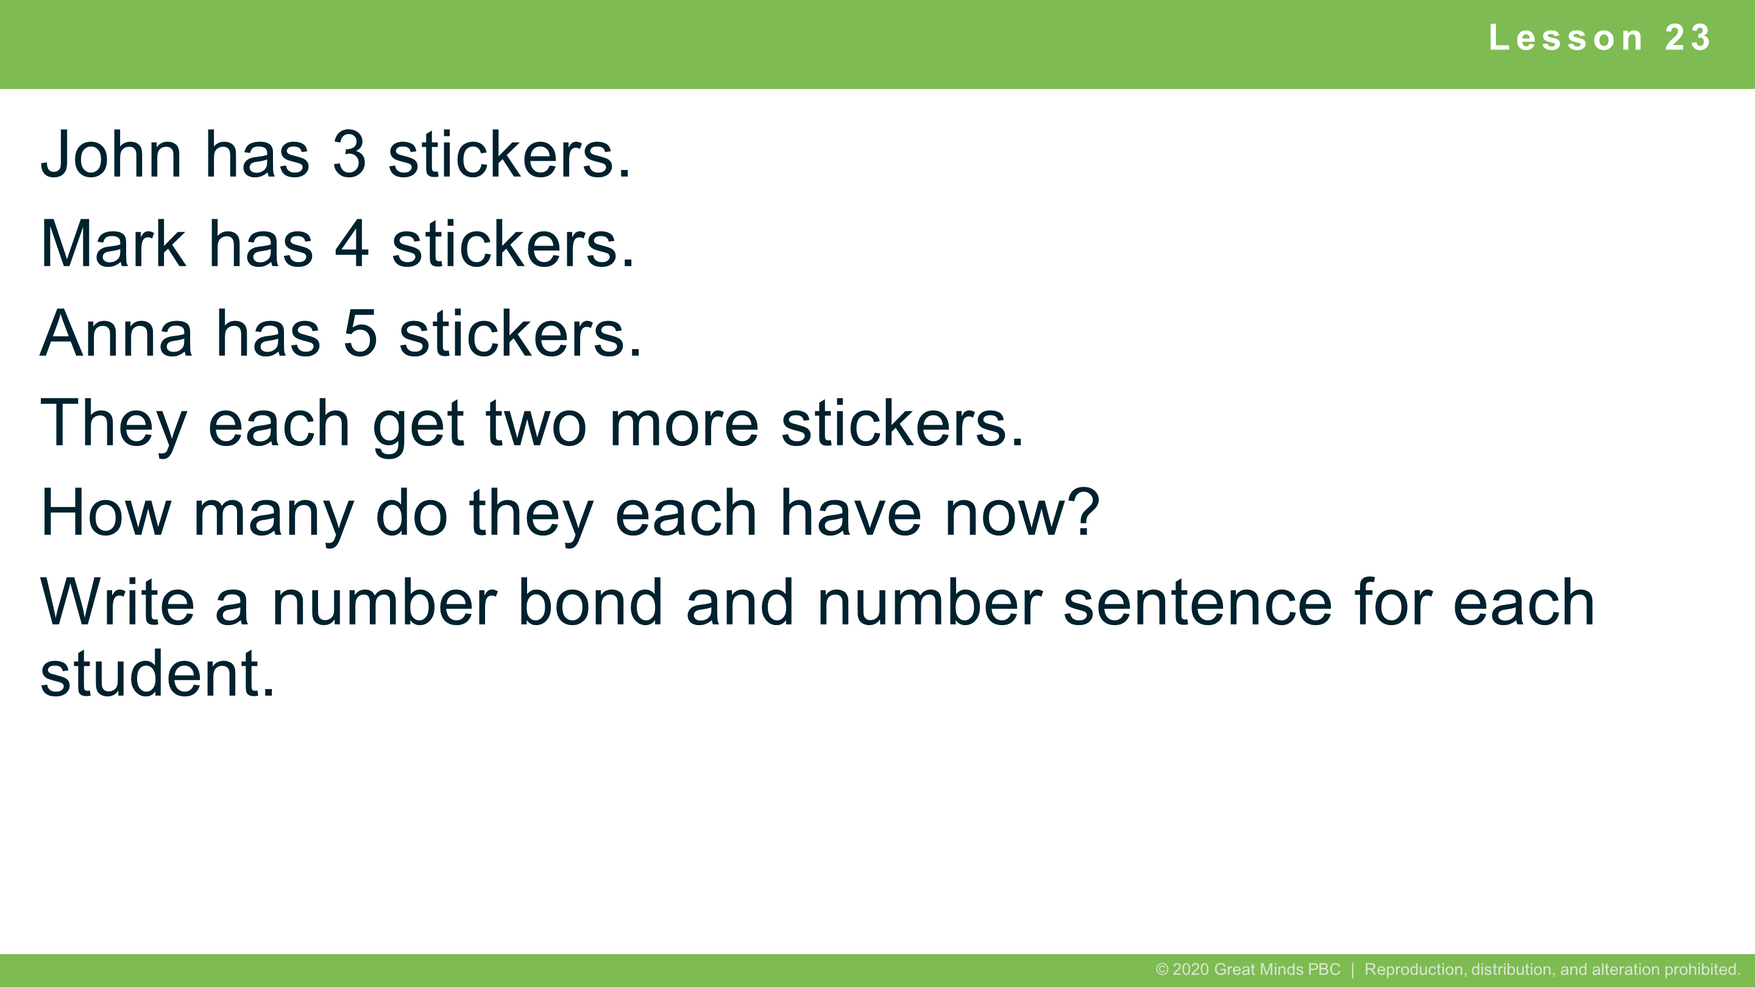
Notes:
Lesson 23
8 minutes
Guided Practice
Extension: How many stickers do John, Mark, and Anna have altogether?
Note: This Application Problem is designed as an application of the previous lesson, which focused on common addends on the addition chart. Students continue to explore the addition chart in today’s lesson, focusing on expressions with the same total.

Slide 11
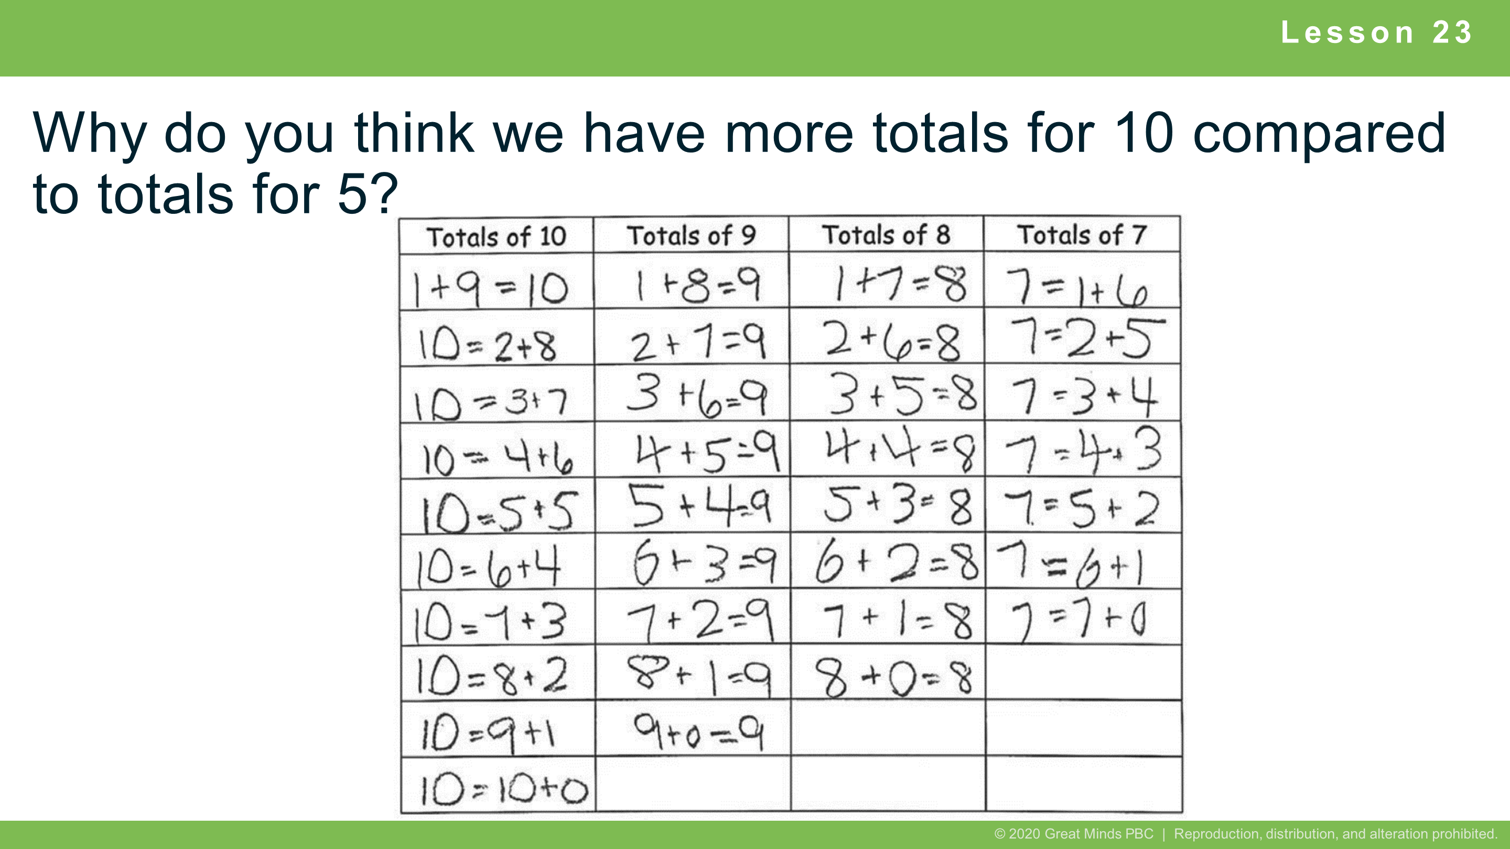
Notes:
Lesson 23
Student Debrief: Connection
Why do you think we have more totals for 10 compared to totals for 5?

Slide 12


Slide 13
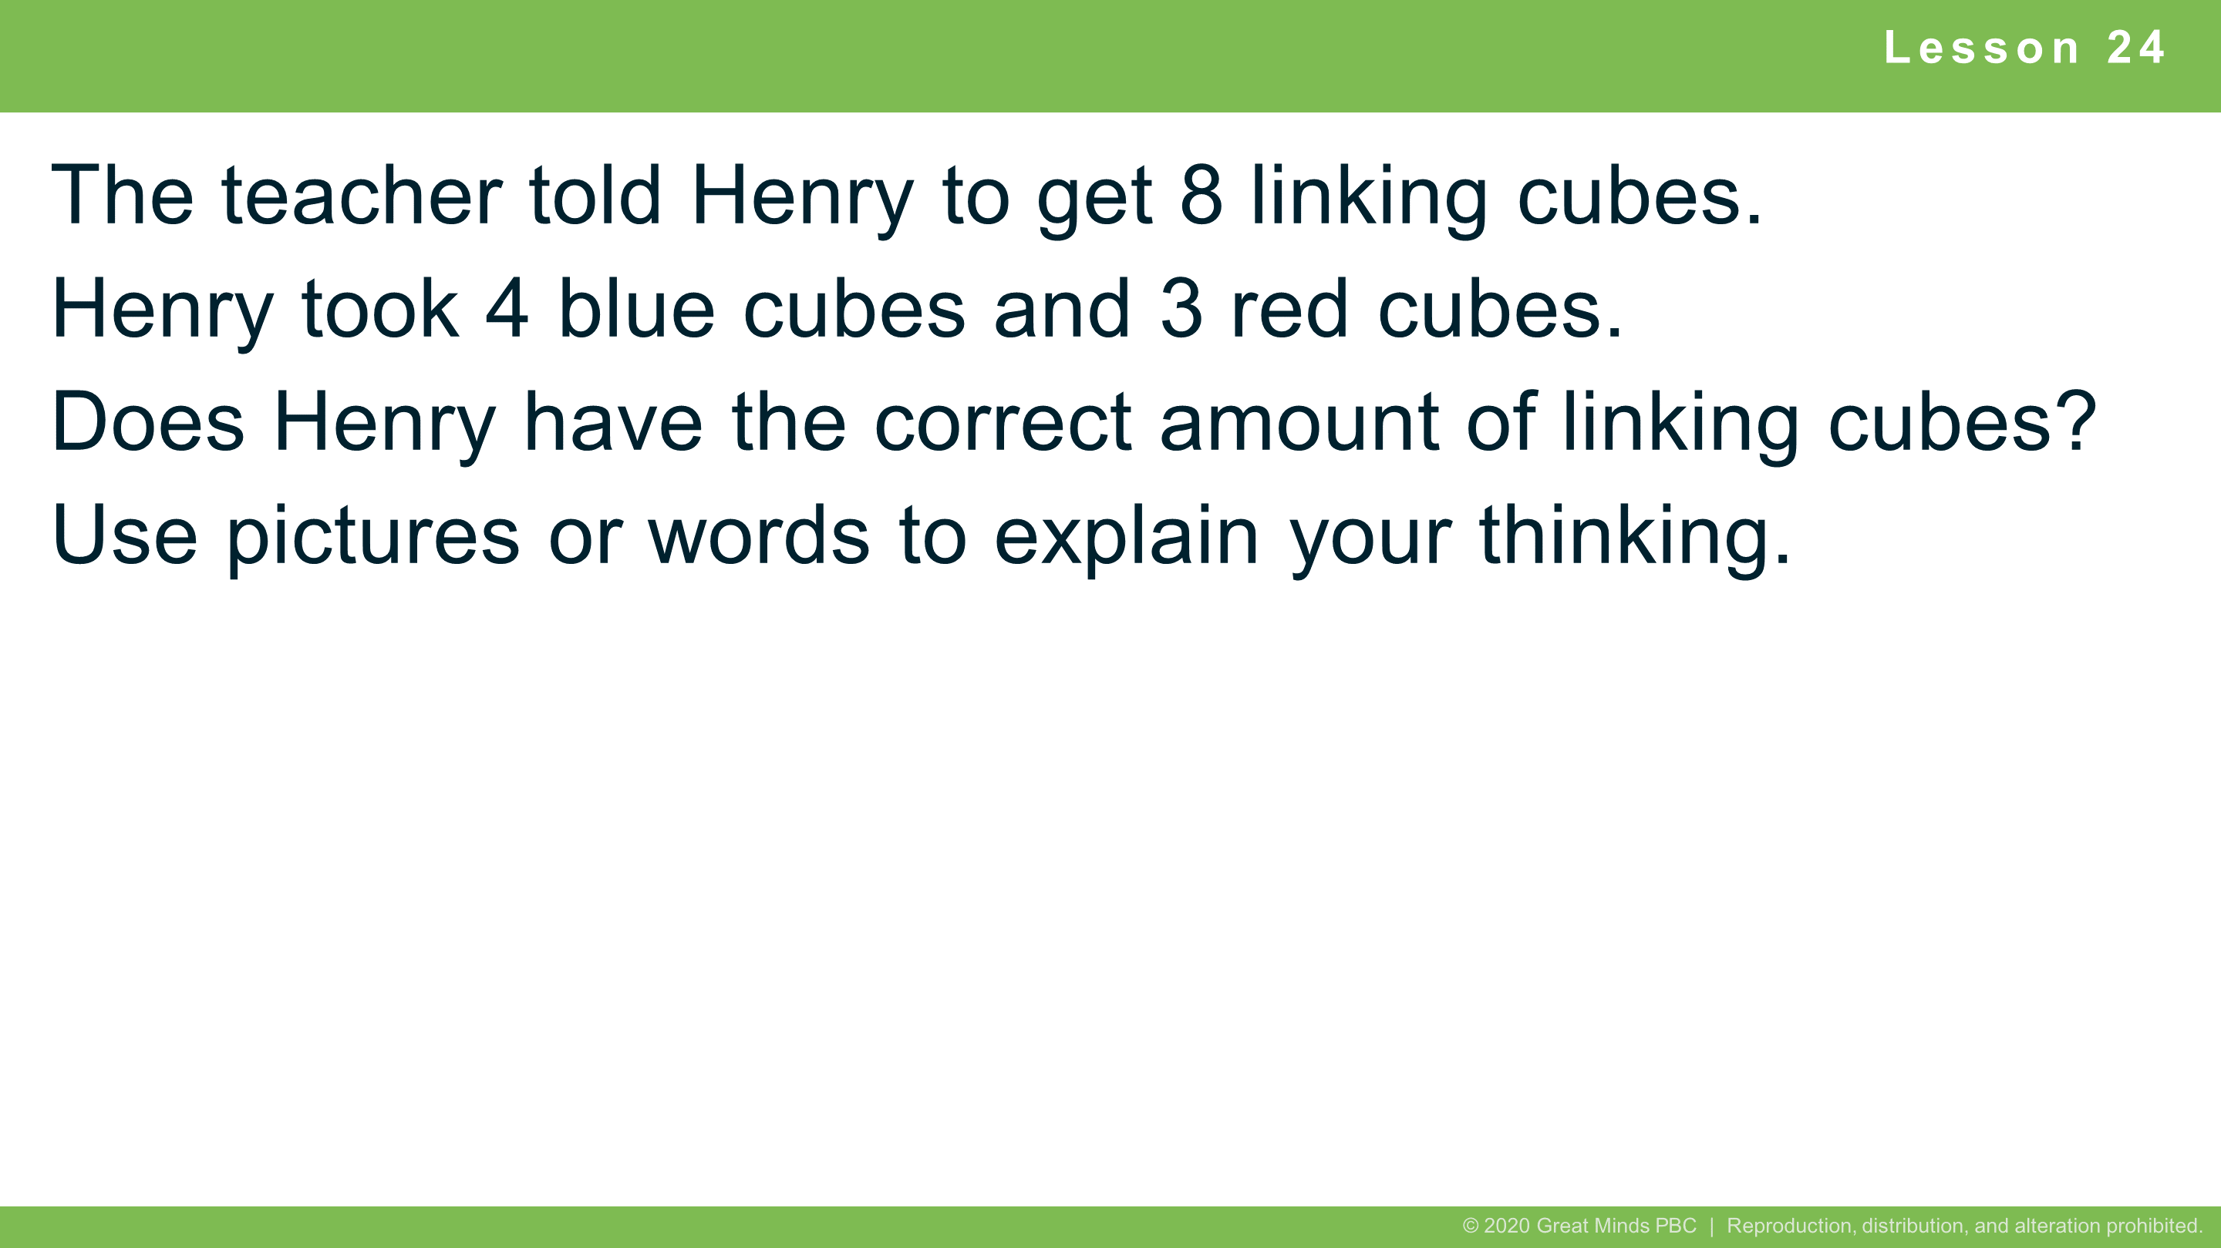
Notes:
Lesson 24
7 minutes
Modeling with Interactive Questioning
Note: This Application Problem is designed as a bridge from the previous lesson’s focus on common totals on the addition chart. Students also discuss the related facts embedded in the problem during the Debrief.

Slide 14
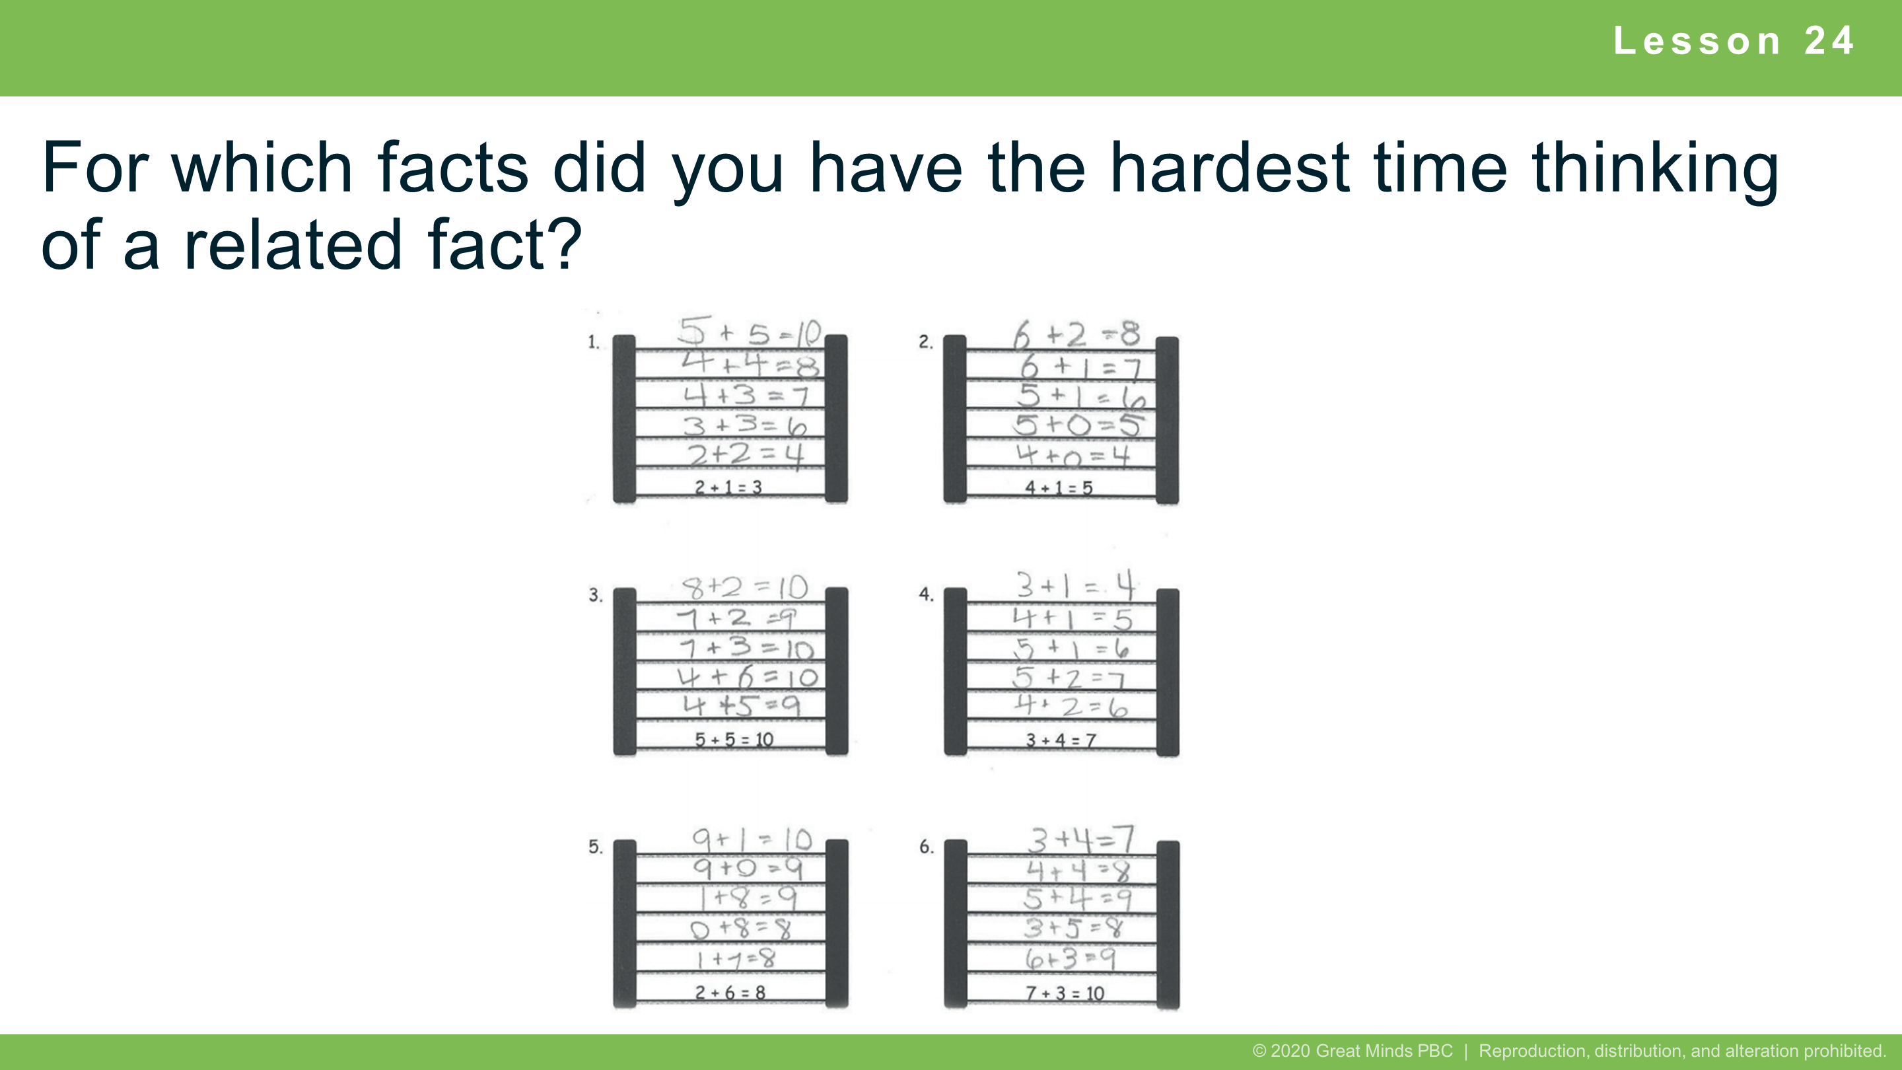
Notes:
Lesson 24
Student Debrief: Connection
For which facts did you have the hardest time thinking of a related fact? Explain what made it difficult and what you decided to do.

Slide 15


Slide 16
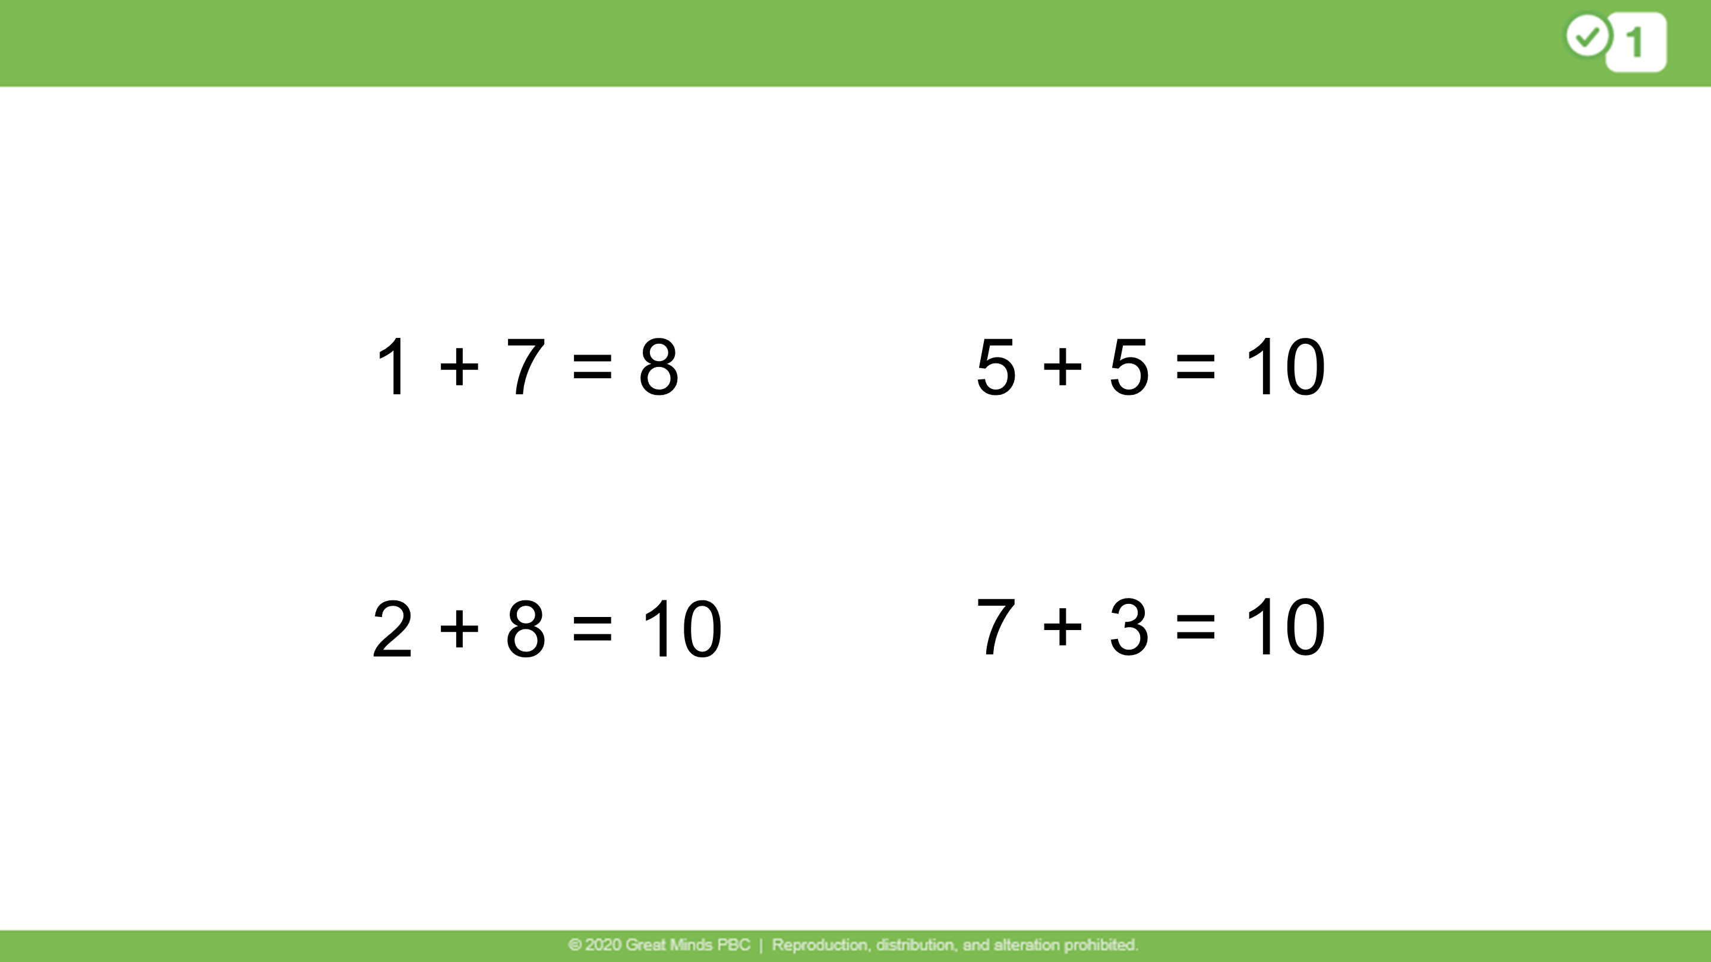
Notes:
This image is taken from G1 M1 L24.
WHICH ONE DOESN’T BELONG?
Ask students which one doesn't belong.
Possible student responses:
1 + 7 = 8 because it is the only one with a solution of 8 rather than 10
5 + 5 = 10 because it’s the only doubles problem
2 + 8 = 10 because it’s the only problem with all even numbers
7 + 3 = 10 because it’s the only problem where the first addend is larger than the second addend.

Slide 17


