Slide 1
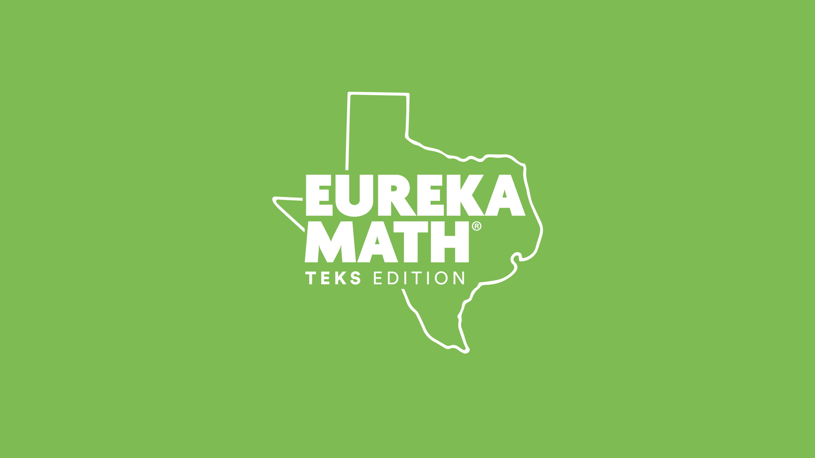

Slide 2
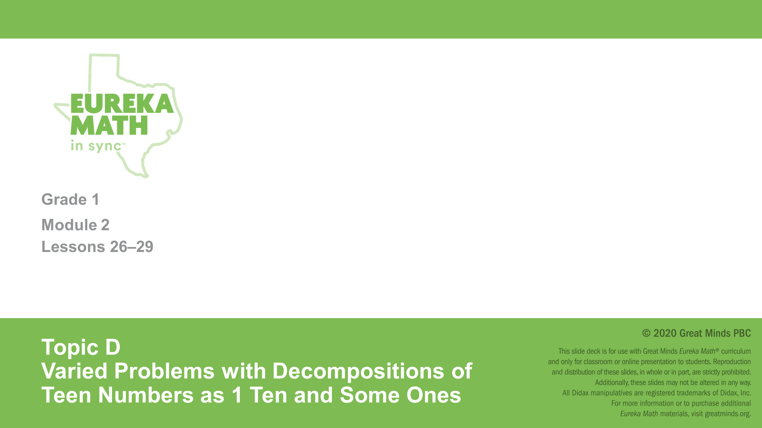

Slide 3
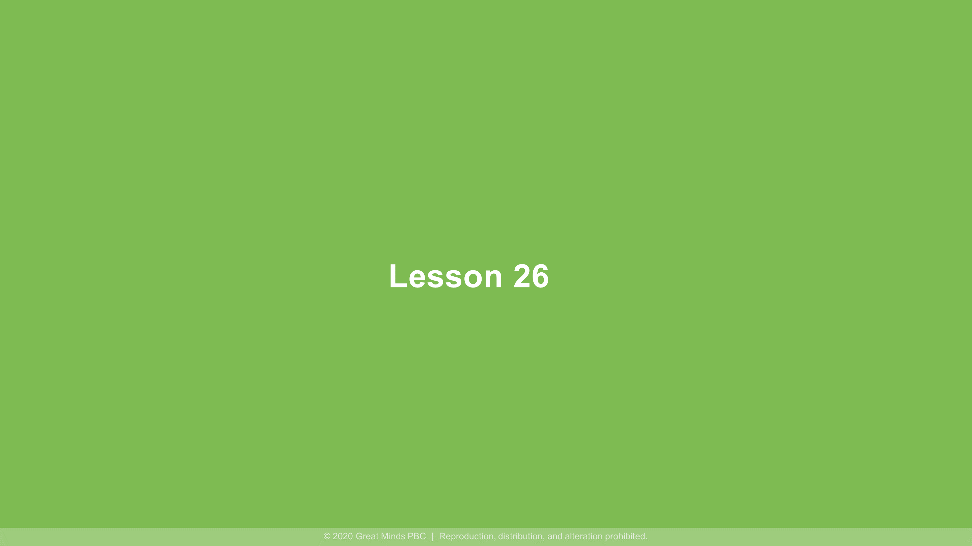

Slide 4
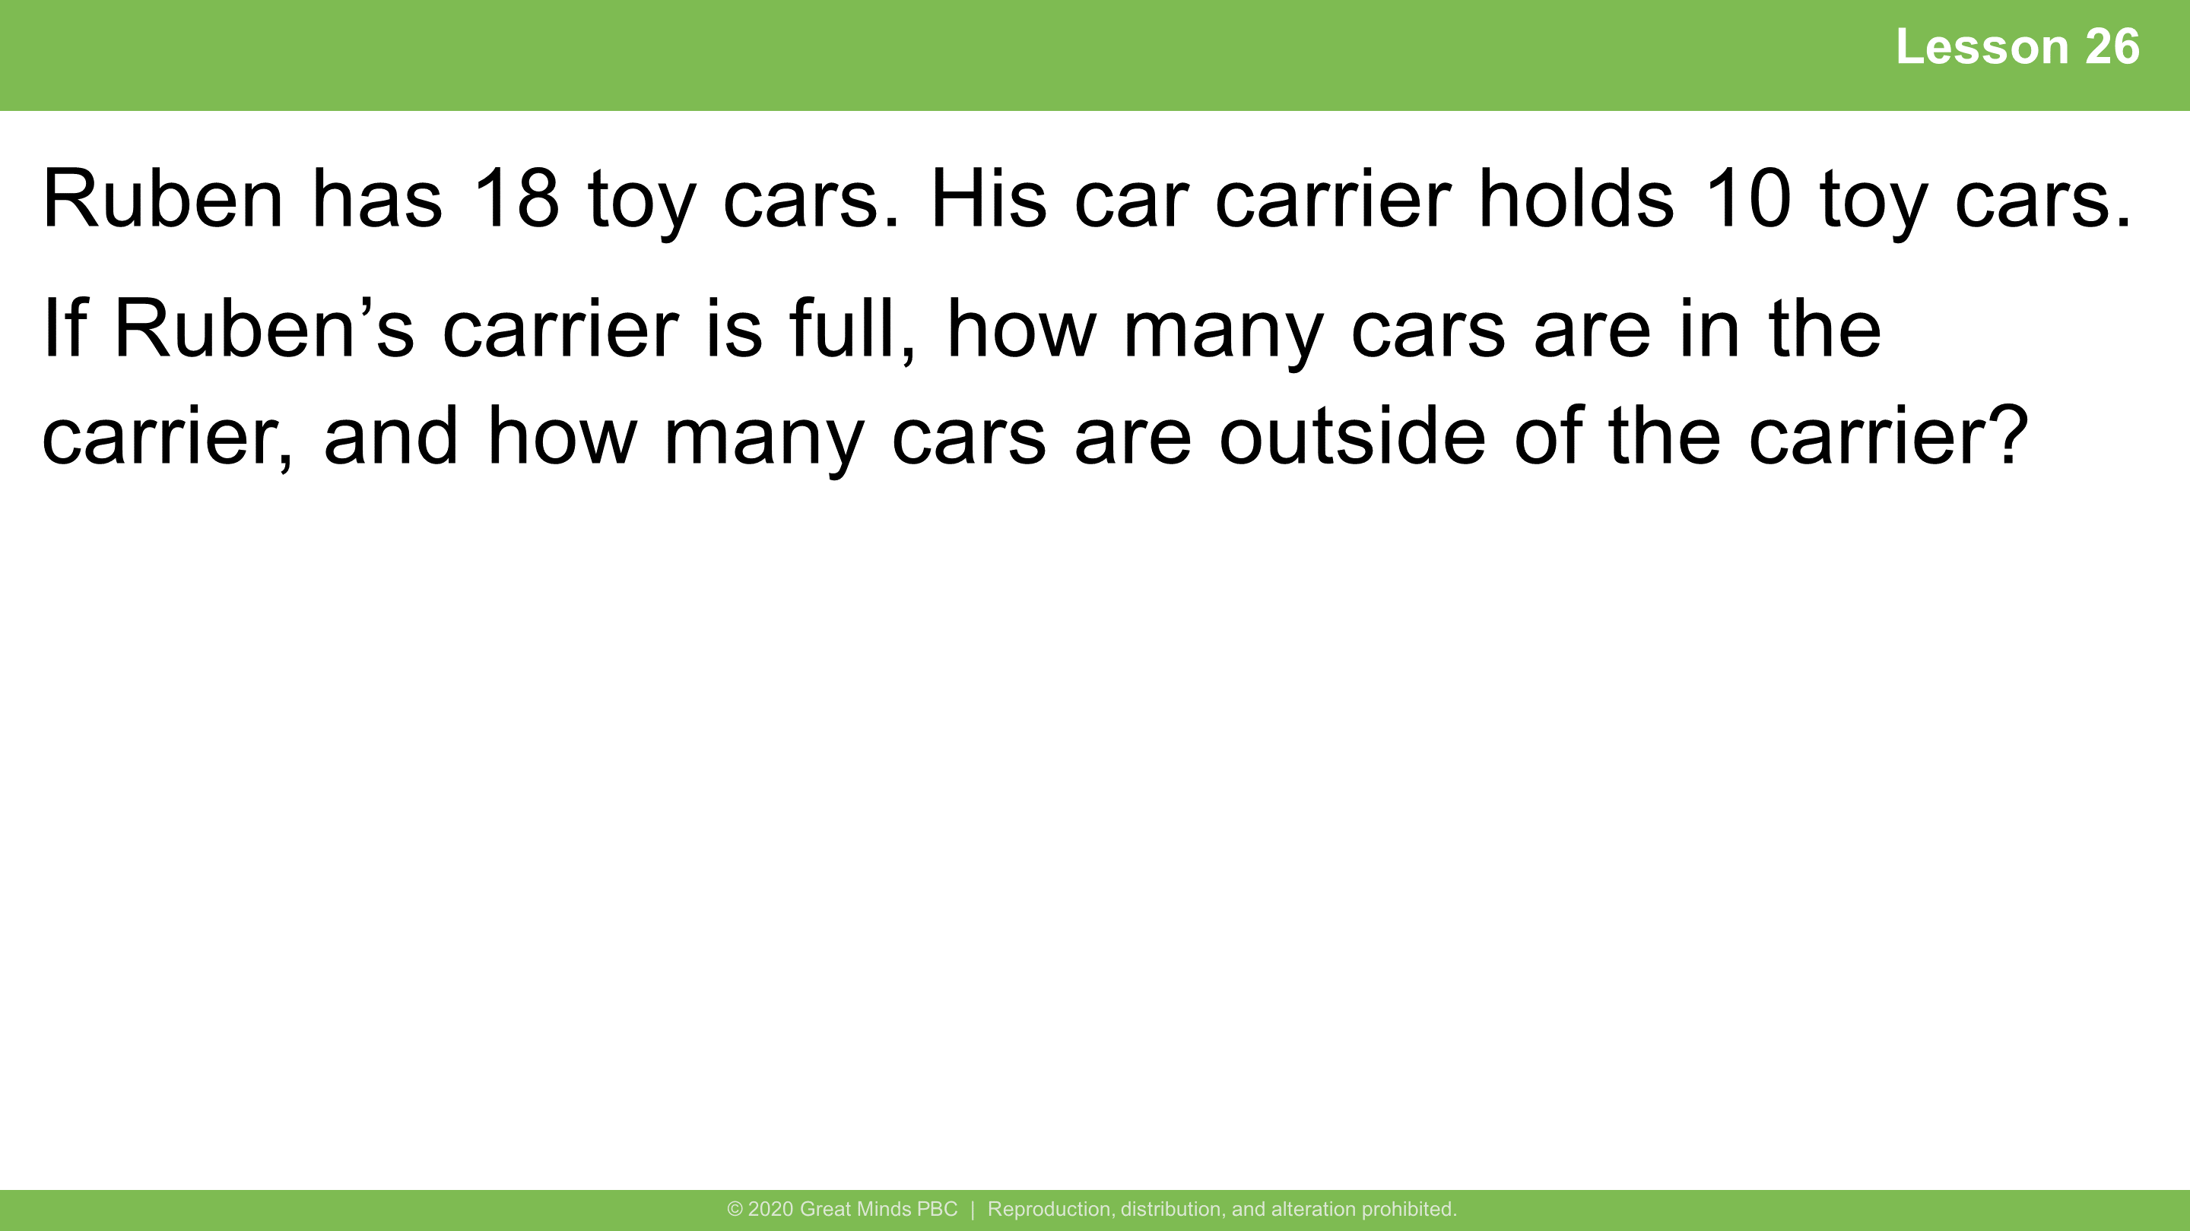
Notes:
Lesson 26
4 minutes
​
Modeling with Interactive Questioning
​
Note: This Application Problem enables students to continue considering situations with missing parts where the context presents a grouping of 10. This grouping of 10 leads into today’s lesson during which students focus on ten as a unit.
​

Slide 5
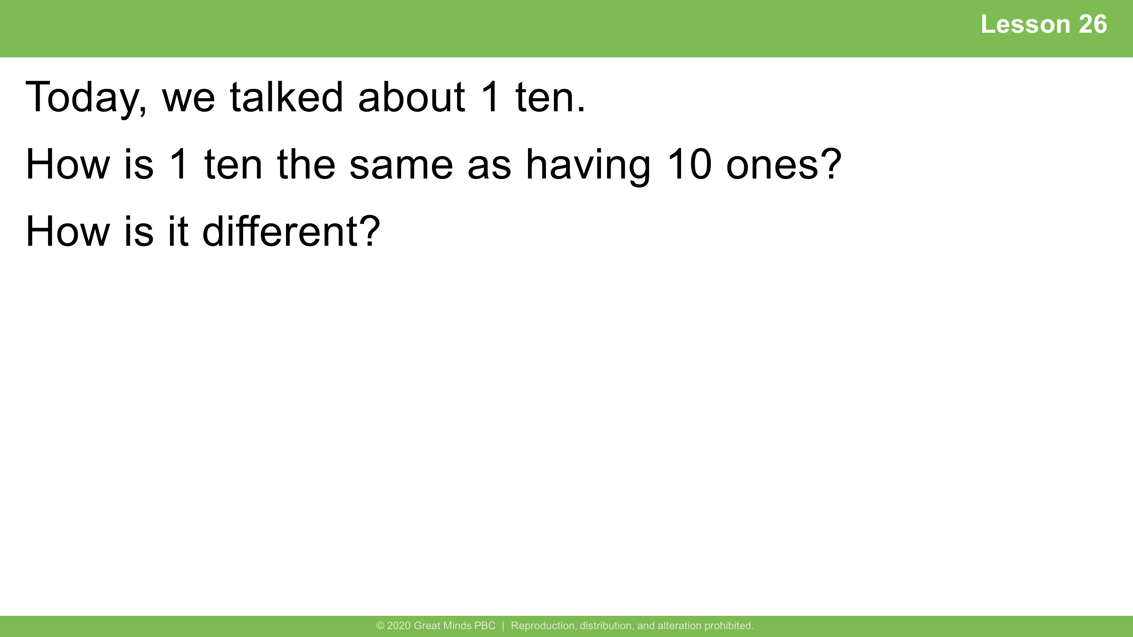
Notes:
Lesson 26
Student Debrief: Impact
​
​Possible student response:
1 ten is the same as having 10 ones because 1 ten is equal to 10 ones. Now we can just bundle the ones to say that it is a group or unit of 10.

Slide 6
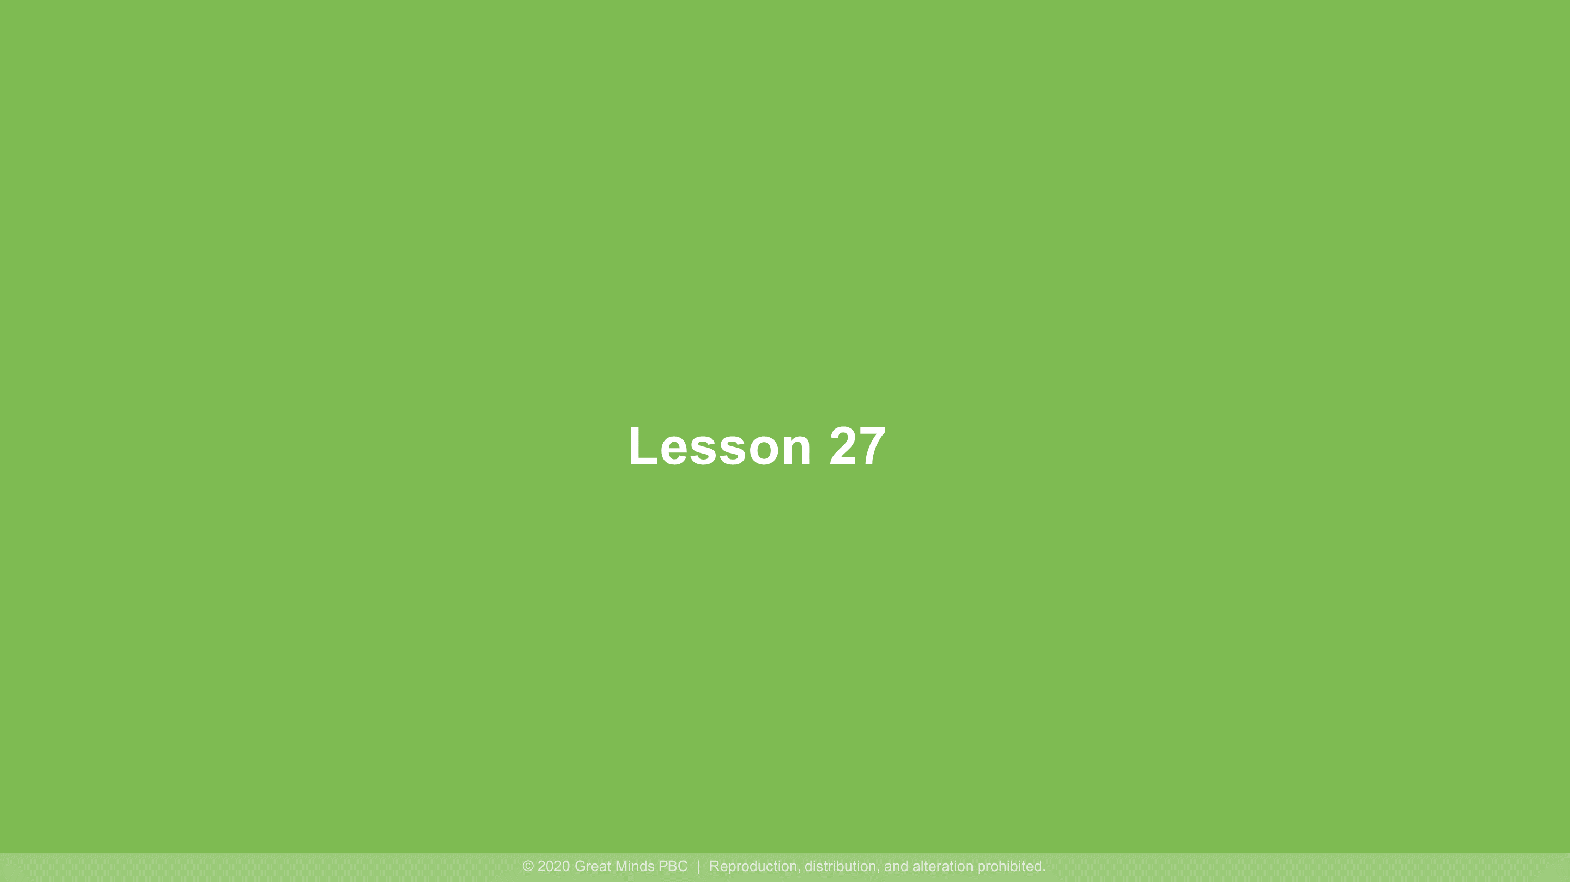

Slide 7
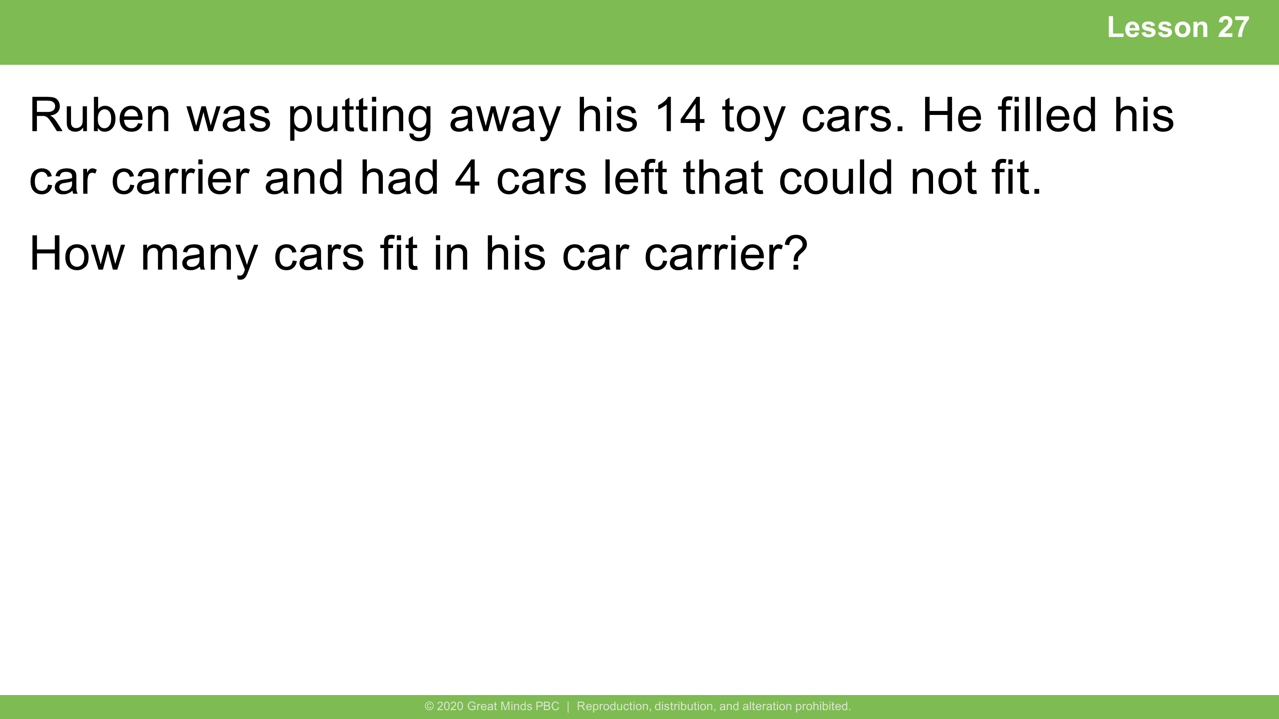
Notes:
Lesson 27
5 minutes
​
Independent Practice
​
Note: This Application Problem allows student to continue to consider contexts where 10 is grouped together within a unit. During the Debrief, the unitization of ten is discussed.

Slide 8
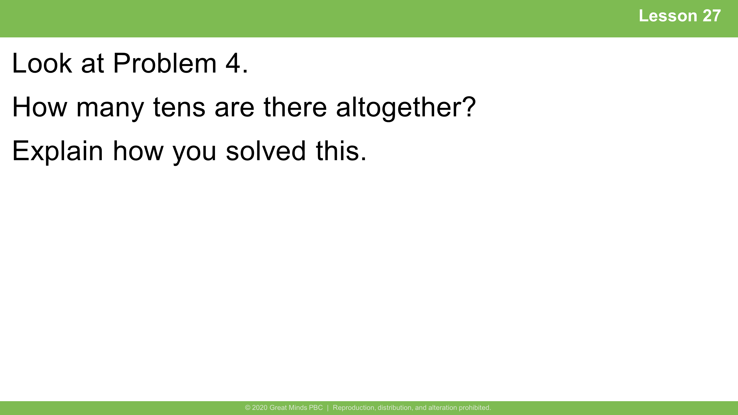
Notes:
Lesson 27
Student Debrief: Impact
​
​Possible student responses:
There are 2 tens altogether. When I counted on 8 from 12, I got 20. I know that 20 is 1 ten plus another ten, so 2 tens!
There are 2 tens altogether. I made a ten with 8 and 2. Then I had 1 ten left. Ten and 1 more ten is 20: 2 tens!

Slide 9


Slide 10
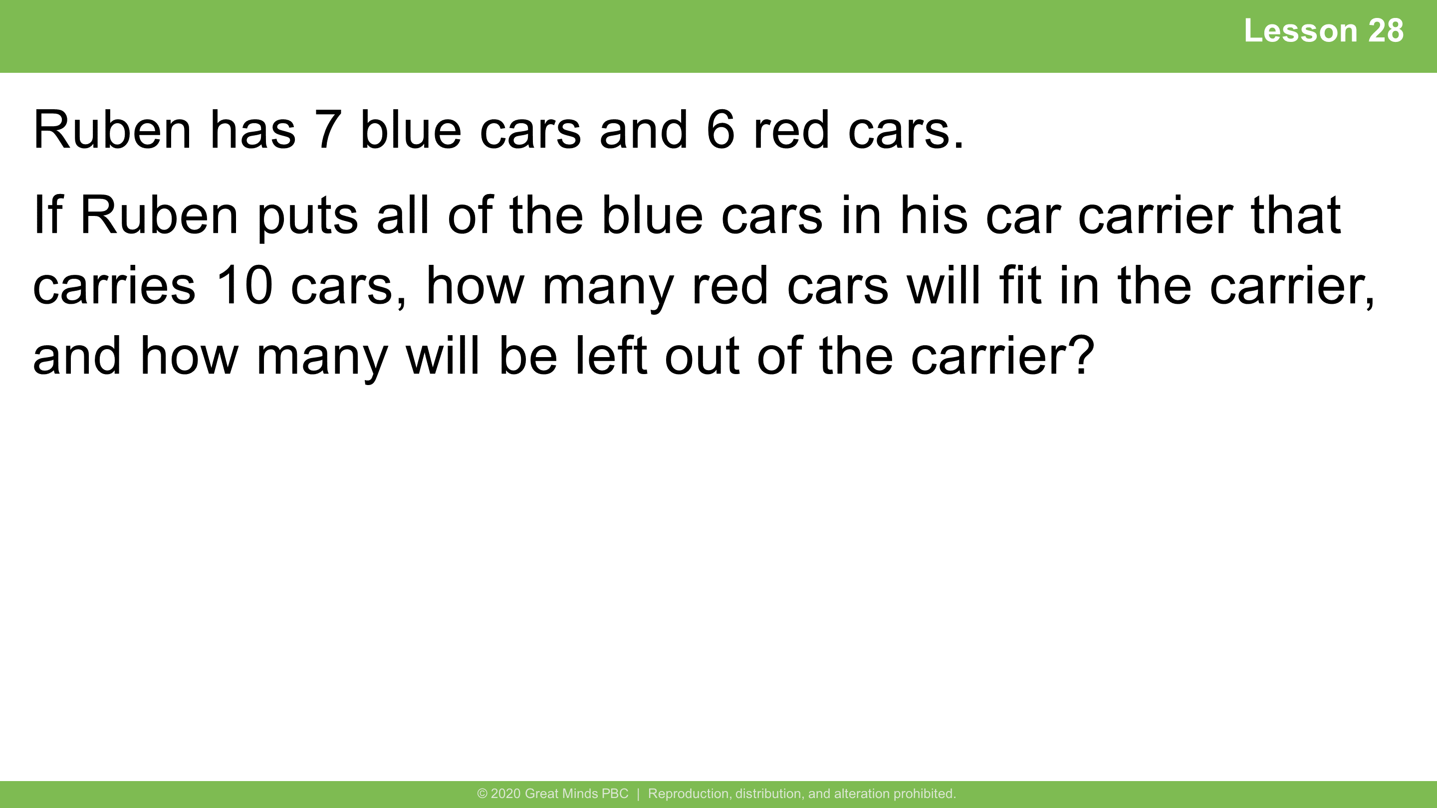
Notes:
Lesson 28
5 minutes
​​
Independent Practice​
​
Note: This Application Problem serves multiple purposes. Some students may respond to the problem with an answer of 13 cars, assuming the question asks, “How many cars does Ruben have?” Look for such misinterpretations as an opportunity to reinforce the importance of reading the question carefully. In addition, the problem gives students a chance to focus on the decomposition of the second addend when creating a unit of ten. This leads into today’s lesson in which students write number sentences to show the two steps in the Level 3 strategy of making ten.
​

Slide 11
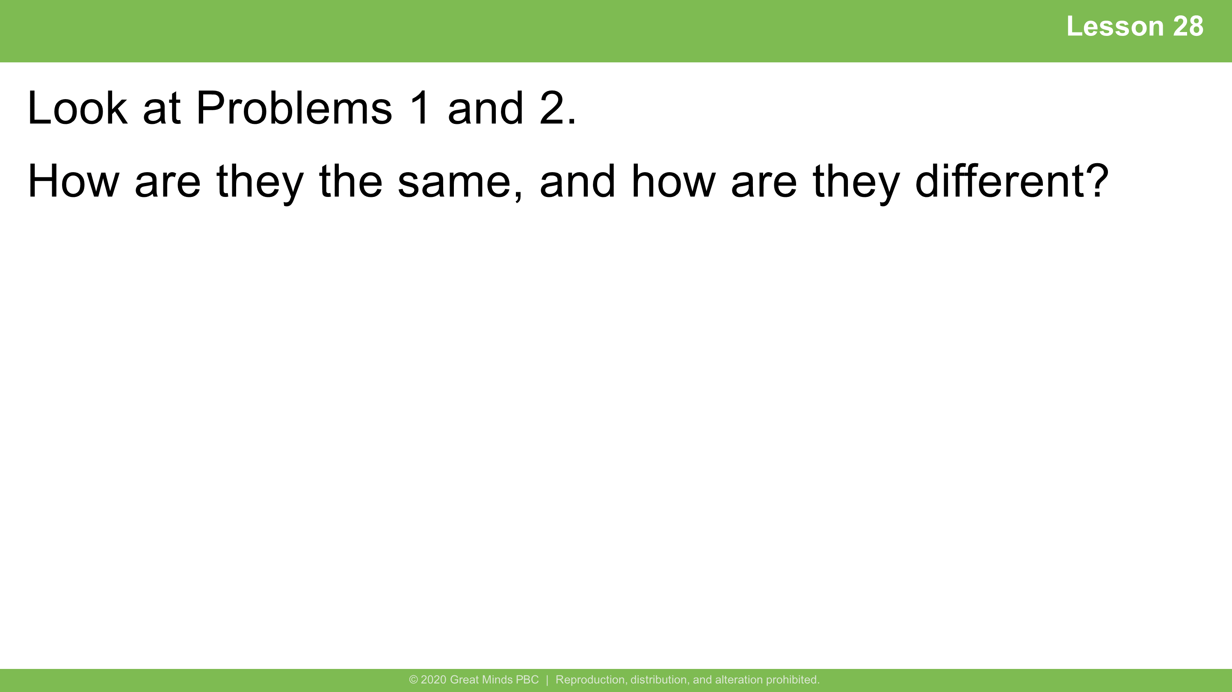
Notes:
Lesson 28
​
Student Debrief: Connection​
​
Possible student responses:
They are the same because they both equal 14.
They are the same because we made10 first.
They are the same because we added 4 more to ten for both problems.
They are different because we had to make ten from 9 and then 10 from 8.
​

Slide 12


Slide 13
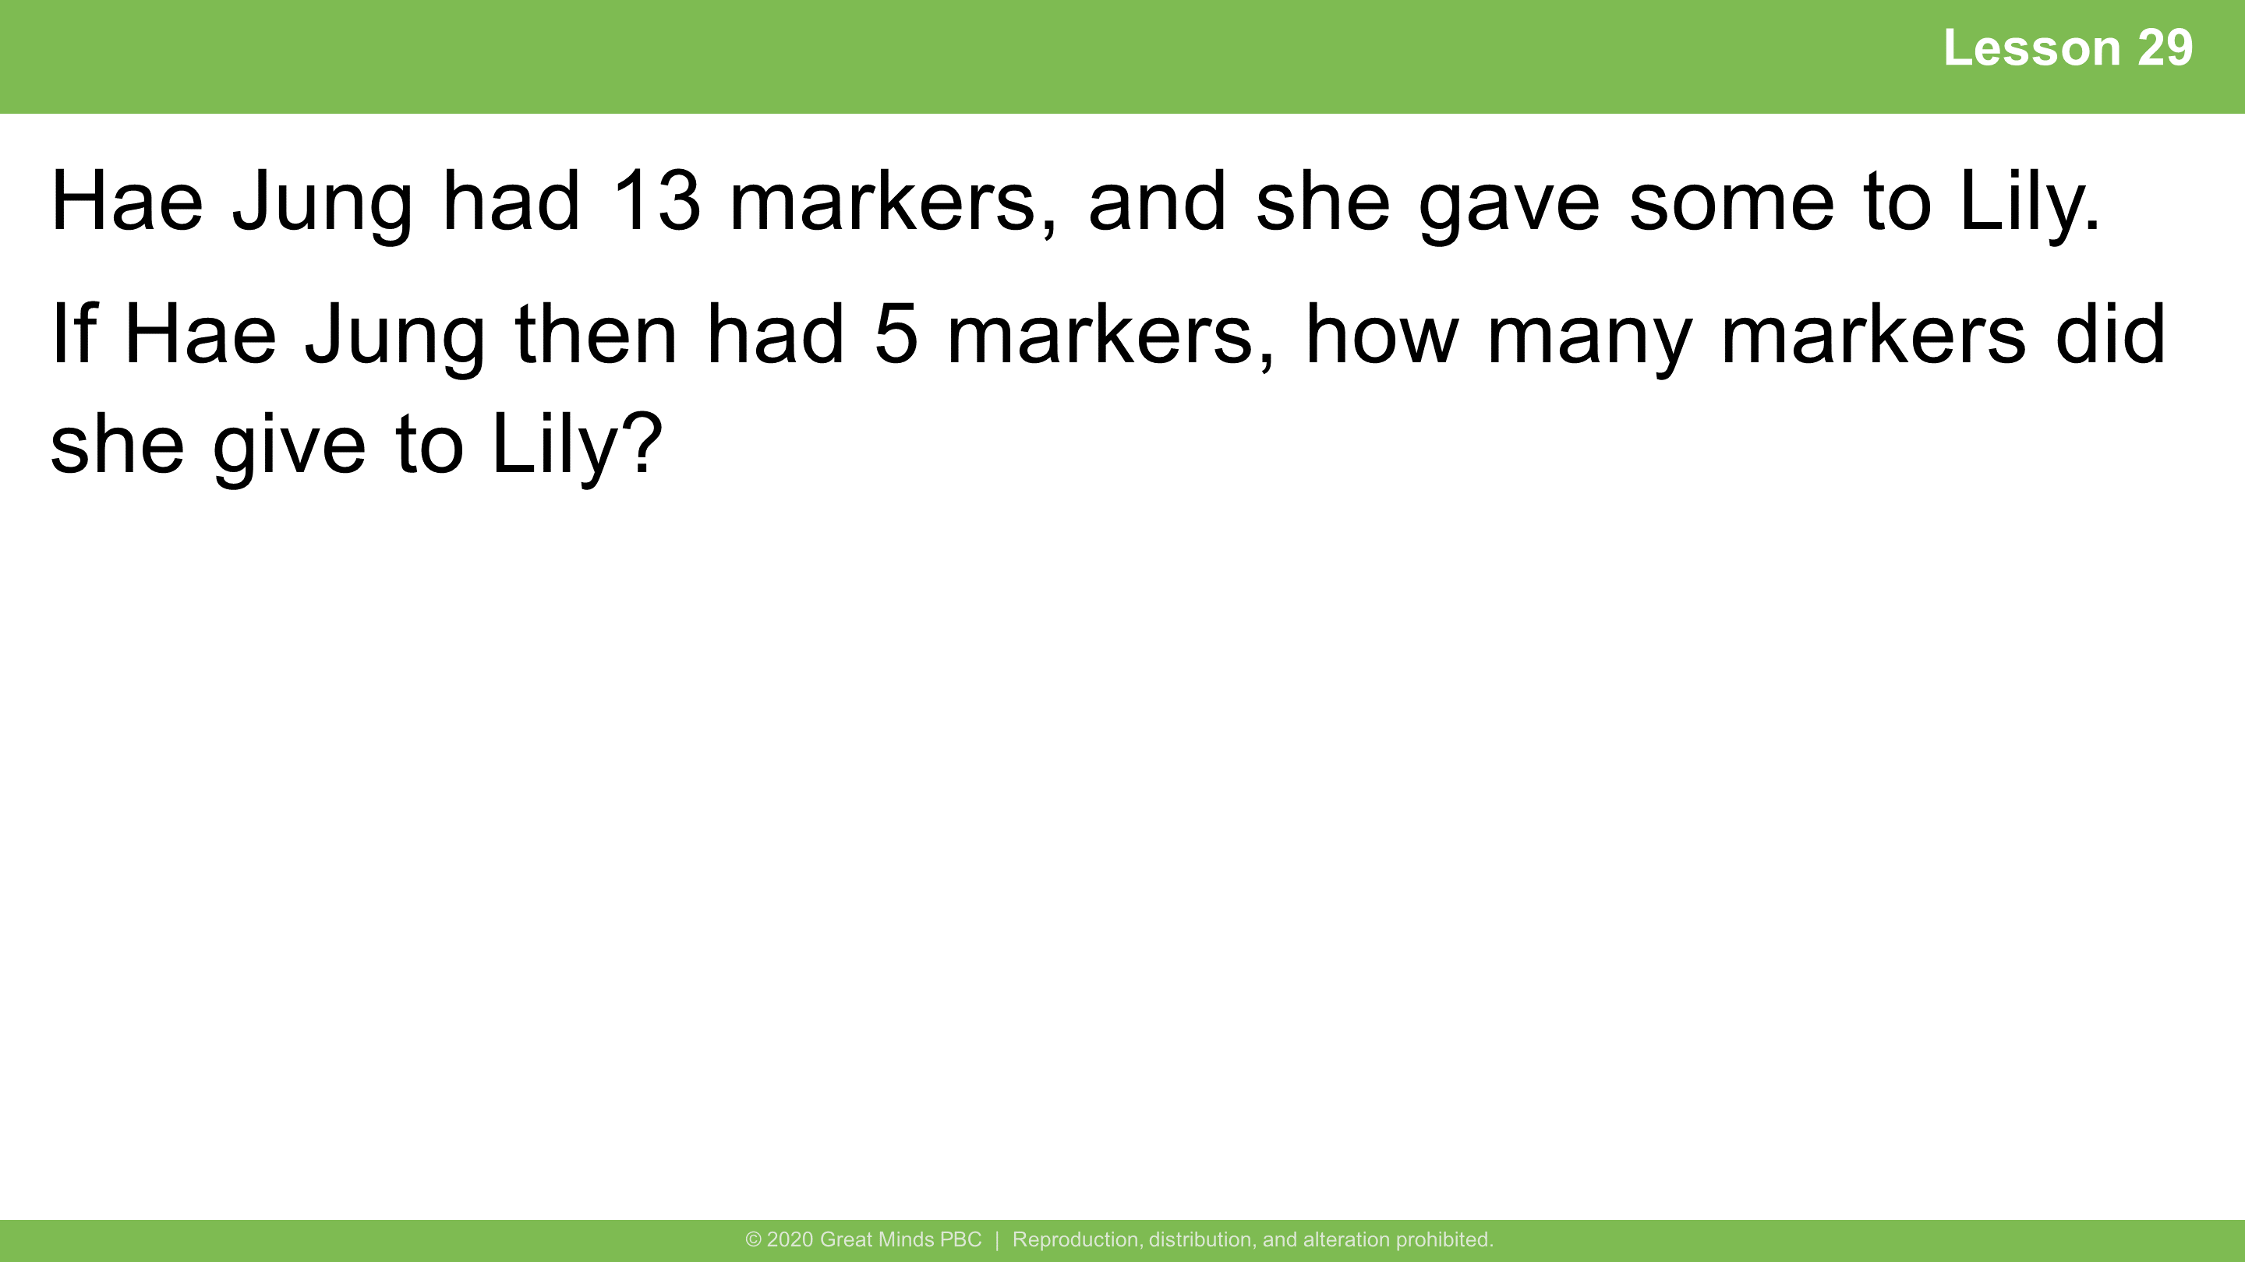
Notes:
Lesson 29
​
5 minutes
Guided Practice
​
Note: In this Application Problem, students continue to consider take apart with addend unknown problem types in this problem. During the Debrief, students have the opportunity to apply today’s objective to the problem, writing number sentences to show the two steps in the Level 3 strategy of taking from ten.
​

Slide 14
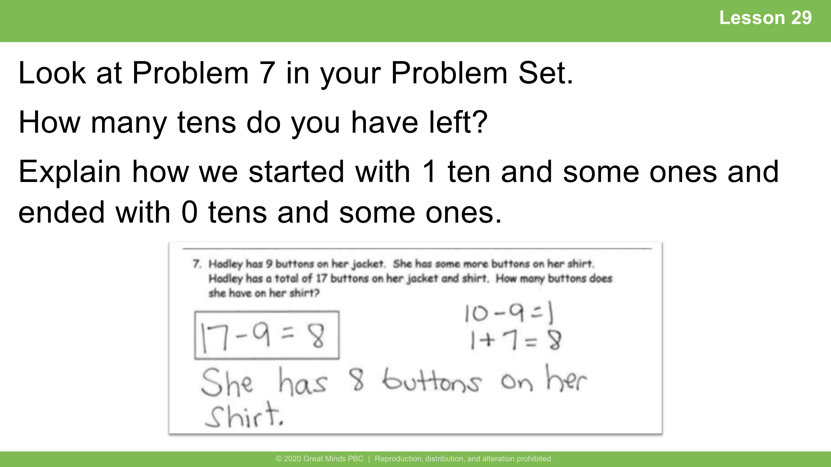
Notes:
Lesson 29
Student Debrief: Connection​
​
Possible student responses:
We took 9 from the ten, which left us with 1, which we added back to the extra 7 ones.
So we have 0 tens and 8 ones.
​

Slide 15


Slide 16
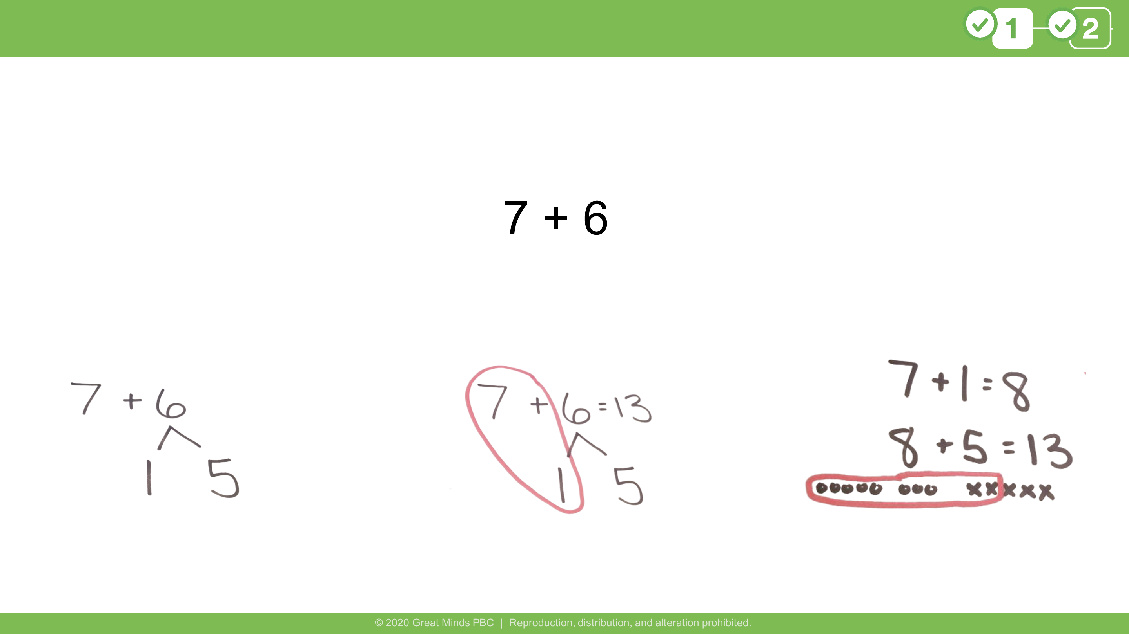
Notes:
​This image is from G1 M2 L28.
​FIVE FRAMING QUESTIONS
Initial Analysis
Present student work to be analyzed (anonymous).
Notice and Wonder: What do you notice? What do you wonder?
Possible student response: I notice the student broke apart 6 into 1 and 5. I’m wondering why the student broke 6 apart this way since neither 7 and 1 or 7 and 5 make 10.
Organize: What steps did the mathematician make? How do you know?
Possible student response: After breaking apart 6 into 1 and 5, they added 7 and 1 to make 8 and then added the other part, 5. I can see where they circled the 7 and 1 and recorded the work.
Advanced Analysis
Reveal: Let’s focus on the make ten strategy. Where do you see it or not see it in this work?
Possible student response: I do not see the make ten strategy in the work. They should have broken apart 6 into 3 and 3.
Distill: What difference might the make ten strategy make in this work?
Possible student response: If they broke apart 6 into 3 and 3, the new easier problem would be 7 + 3 = 10, and 10 + 3 equals 13.
Know: How is the make ten strategy helpful when adding?
Possible student response: It is helpful because it makes the problem easier. By making ten, the easier problem is a 10+ fact, which we know how to do quickly!
​
Note: It is essential to note that the work is not incorrect. It isn't particularly helpful to break apart 6 into 5 and 1. When we break numbers apart and put them back together, it is to make the problem easier. By making ten, the final two parts to add back together is a 10+ fact, which makes the problem easier.
​

Slide 17
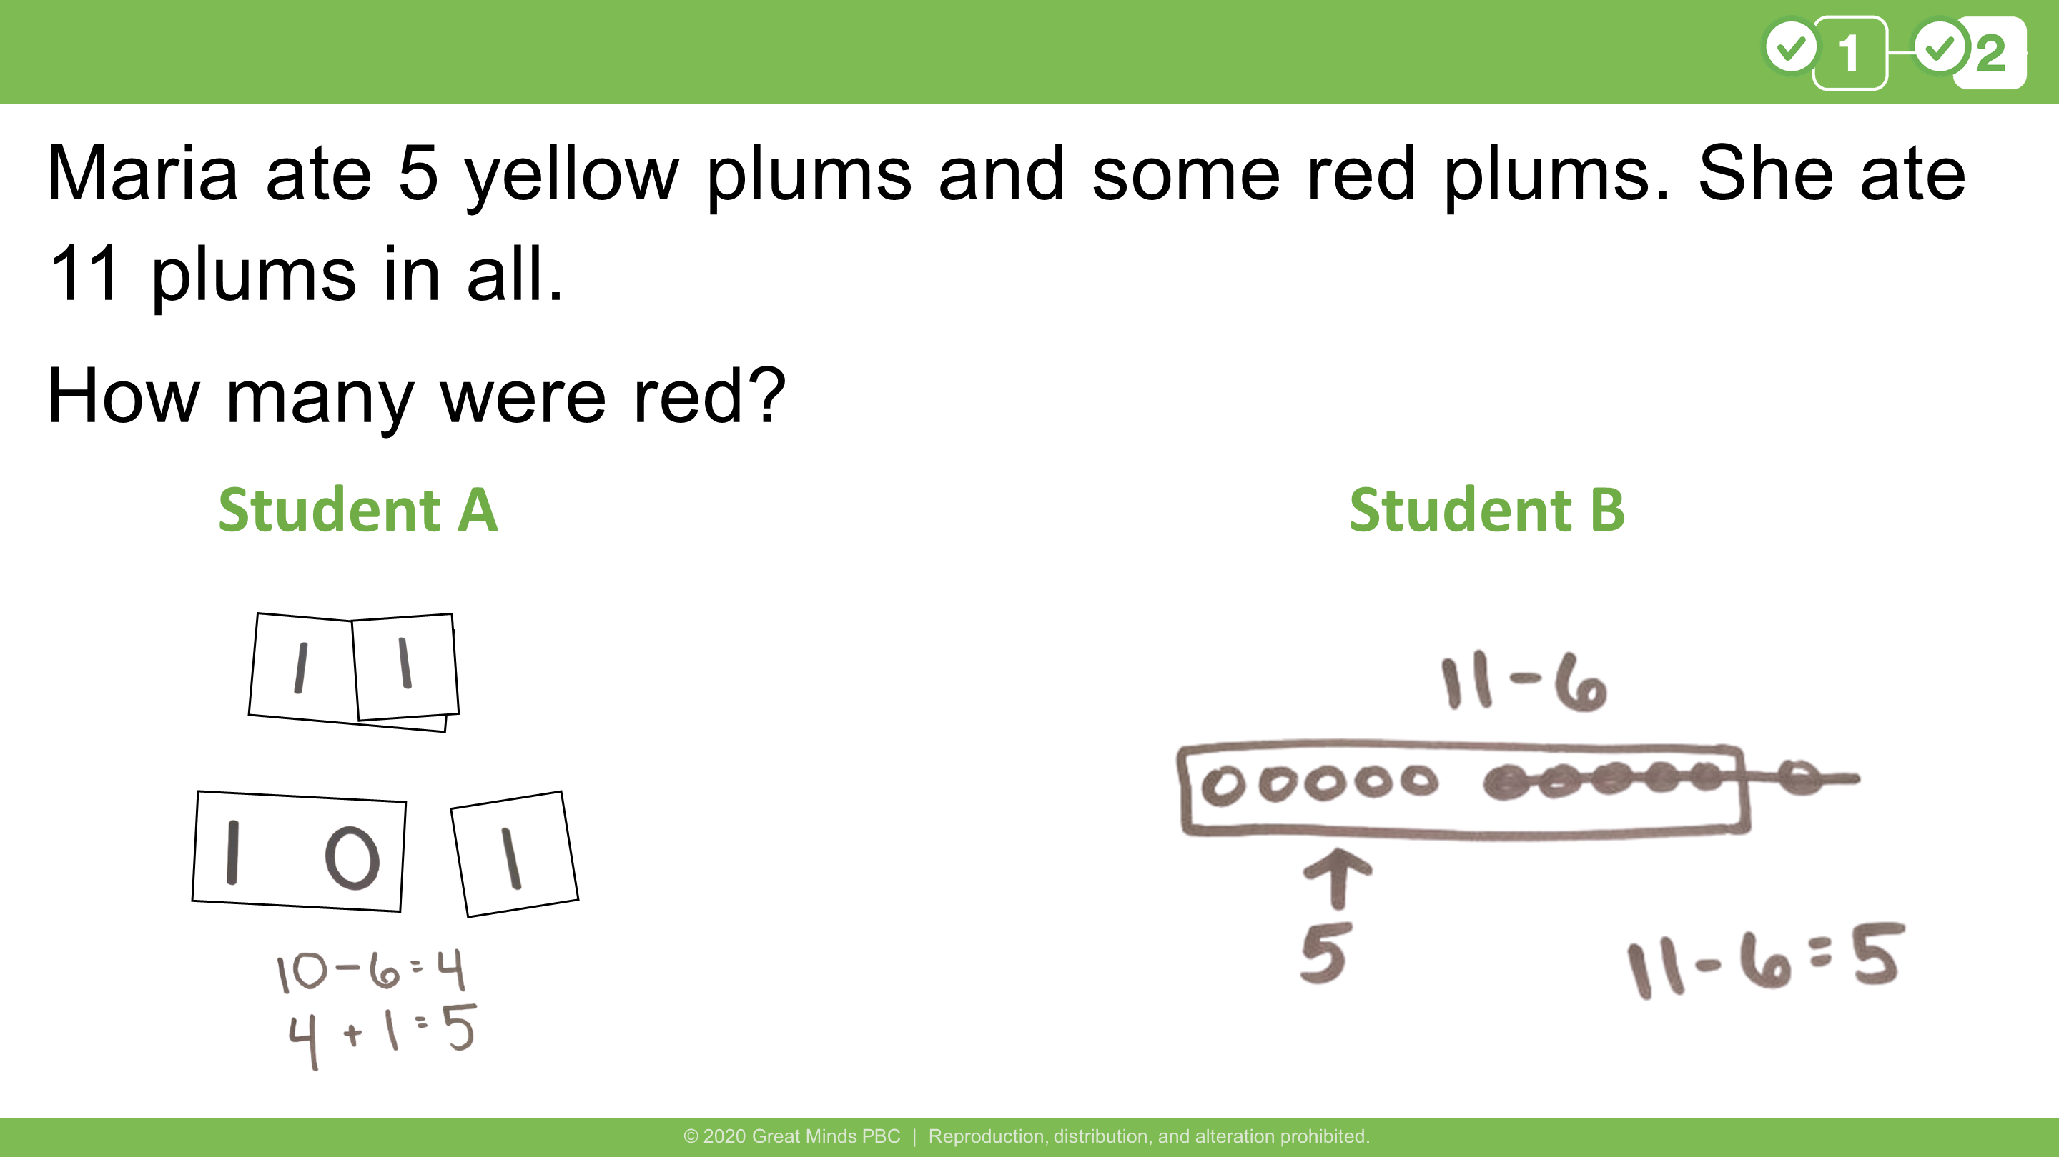
Notes:
This slide is in reference to G1 M2 L29 Problem 4.
​
TAKE A STAND
Show slide with problem and two student work samples.
Read the following statement and ask students to decide if they agree, maybe agree, or disagree with this statement: Both students are correct and used the take from ten strategy.
Provide signs for students to stand next to or select in a virtual context: Agree, Maybe, Disagree.
Present a problem and have students stand near or point to the sign that best describes their claim.
Give time for groups to discuss their reasoning.
Groups share with the class; students may change their minds.
Individuals reflect on key takeaways.
​
Possible student response:
Maybe: Both students are correct, and their work is correct, but only Student A used the take from ten strategy.
​
Note: It is important to highlight that Student B's work is correct; it just doesn’t show the take from ten strategy because they did not take 5 from the group of ten. Some students will recognize that 11 – 6 is a doubles plus 1 fact (5 plus 5 plus 1 equals 11).
​

Slide 18
