Slide 1
MATTER
PhD PROJECTED
Copyright © 2020 Great Minds PBC
This slide deck is for use with Great Minds PhD Science® TEKS Edition curriculum and only for classroom or online presentation to students. Except where otherwise noted, this content is published under a limited public license with the Texas Education Agency. Use limited to Non-Commercial educational purposes.
For more information or to purchase additional
PhD Science materials, visit greatminds.org/texas

Slide 2
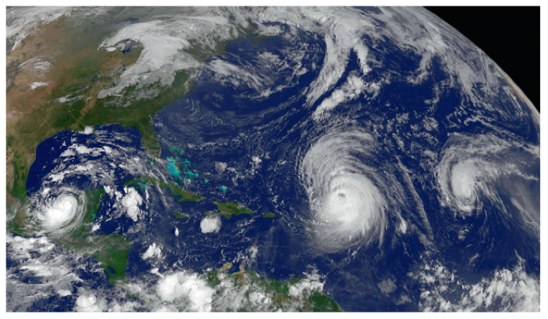
Matter
Concept | Lesson
Concept 1 | 1 | 2 | 3 | 4 | 5 | 6 | 7 | 8 | 9 | 10 | 11 | 12 | 13
Concept 2 | 14 | 15 | 16 | 17 | 18 | 19
Concept 3 | 20 | 21 | 22 | 23
Engineering Challenge | 24 | 25 | 26 | 27 | 28
Socratic Seminar & End-0f-Module Assessment | 29 | 30 | 31

Slide 3
1

Slide 4
Observe materials.
What do you notice about these materials?

Slide 5
Explore Bird Nest Building Materials

Slide 6
What do you know about birds?

Slide 7
How might birds use these materials to build their nests?

Slide 8
How might you show your ideas?

Slide 9
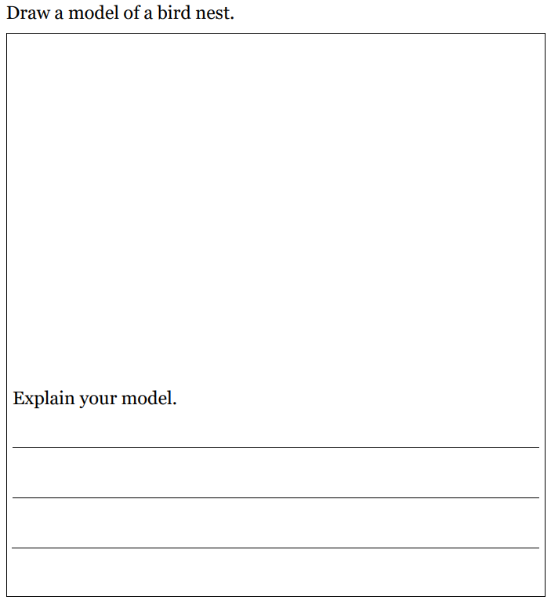
Develop Initial Models
Lesson 1 Activity Guide

Slide 10
Compare Bird Nests

Slide 11
What do you notice about the blue jay nest?

Slide 12
How is the blue jay nest similar to your model?

Slide 13
How is the blue jay nest different from your model?

Slide 15
What ideas do you have about the materials baya weavers use to build these hanging nests?

Slide 16
What questions do you have about the baya weaver nests?

Slide 17
What can a bird nest look like?

Slide 18
Look for local birds and bird nests in your neighborhood, and draw a picture of what you see. You should not touch or disturb nests or materials you find in and around nests.
Homework

Slide 19
2

Slide 20
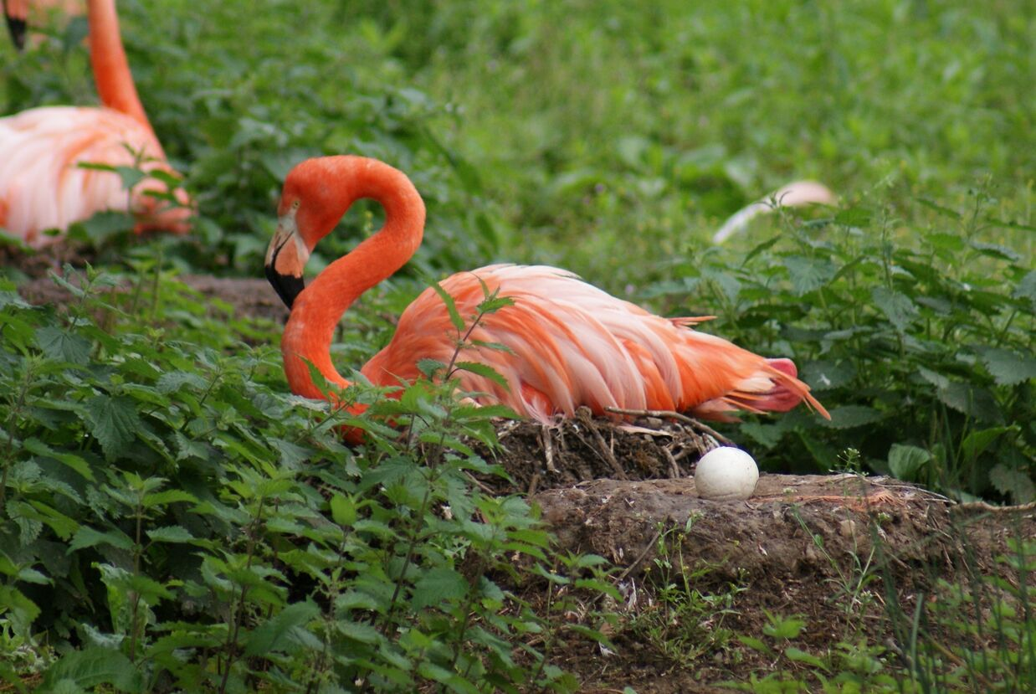
Observe materials.

Slide 21
Why do these nests look so different?

Slide 22
What materials do you think is each nest made of?

Slide 23
A Nest Is Noisy, Pages 1–4, 5–24, and 25–28

Slide 24
What can a bird nest look like?

Slide 25
What materials do the different kinds of birds build their nests with?

Slide 26
Develop Anchor Model
Lesson 1 Activity Guide

Slide 27
What new questions do you have about different kinds of bird nests?

Slide 28
3

Slide 29
Discuss bird nest materials.

Slide 30
Discuss the characteristics of a material.
Are the other materials birds use to build their nests the same as this material?
Why or why not?

Slide 31
Examine Objects and Materials

Slide 32
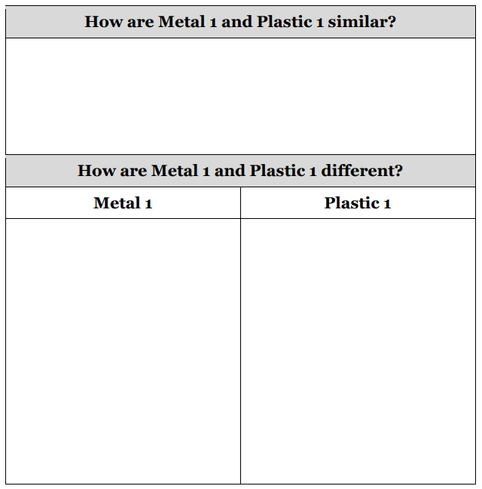
Record your observations.
Lesson 3 Activity Guide

Slide 33
Class Comparison Chart
Lesson 3 Activity Guide

Slide 34
Group the words and phrases into categories.

Slide 35
How are Metal 1 and Metal 2 similar?

Slide 36
How are Metal 1 and Metal 2 different?

Slide 37
Which categories contain words or phrases that are the same for Metal 1 and Metal 2?

Slide 38
Which categories contain words or phrases that are different for Metal 1 and Metal 2?

Slide 39
Why do you think Metal 1 and Metal 2 have the same color, texture, flexibility, and hardness?

Slide 40
material
anything that an object is made of or can be made of

Slide 41
object
a certain amount of material or materials put together in a certain way

Slide 42
property
anything about an object or material that can be observed or measured

Slide 43
Based on what have learned about materials and objects, where on are our class list should we write “Properties of Materials”?

Slide 44
Where on our class list should we write “Properties of Objects”?

Slide 45
Develop Anchor Chart and Update Anchor Model

Slide 46
How can you apply your new understandings of objects and materials to bird nests?

Slide 47
Develop Driving Question Board

Slide 48
Why do different kinds of birds use certain materials to build their nests?

Slide 49
4

Slide 50
Hummingbird Video

Slide 51
What did you see in the video?

Slide 52
What questions do you have about what you saw?

Slide 53
Class Properties List

Slide 54
Which words from the class list describe the hummingbird nest material?

Slide 55
Observe Samples

Slide 56
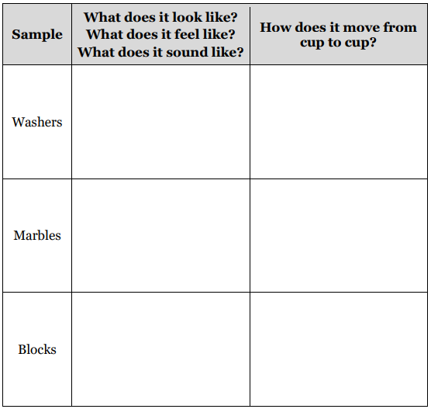
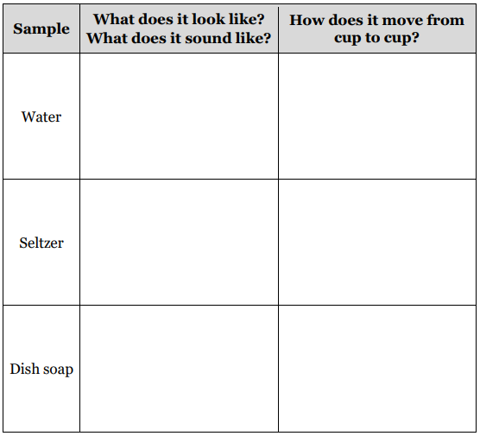
Write or draw what you observe.
Lesson 4 Activity Guide

Slide 57
How could you use the magnifiers, jars, and cups to observe the different samples?

Slide 58
Debrief Observation Activity
Class Properties List

Slide 59
What new questions do you have about the properties of objects and materials?

Slide 60
Describe properties of a pencil.

Slide 61
5

Slide 62
What do you notice about the picture?

Slide 63
Class Properties List
How could you group the shapes by using some of the properties on the class list?

Slide 64
classify
to group things by the properties they
have in common.

Slide 65
Class Properties List
How could you classify the objects and materials you observed
in the previous lesson?

Slide 66
Classify Objects and Materials

Slide 67
Debrief Classification Activity

Slide 68
How did you classify the samples?

Slide 69
Class Properties List

Slide 70
When have you heard or used the words solid and liquid?

Slide 71
How would you describe the samples classified as solids?

Slide 72
How would you describe the samples classified as liquids?

Slide 73
Describe solids and liquids.

Slide 74
In what ways are solids and liquids different?

Slide 75
6

Slide 76
Hummingbird Video

Slide 77
Is the cotton ball a solid or a liquid?

Slide 78
What evidence supports your thinking about the cotton ball?

Slide 79
How might we learn more about solids and liquids to improve our descriptions of them?

Slide 80
Explore Solids and Liquids

Slide 81
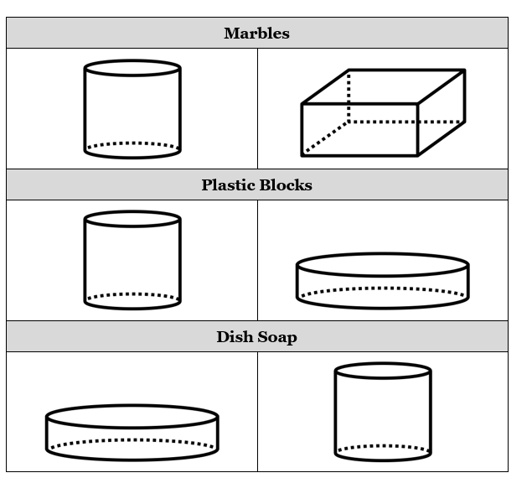
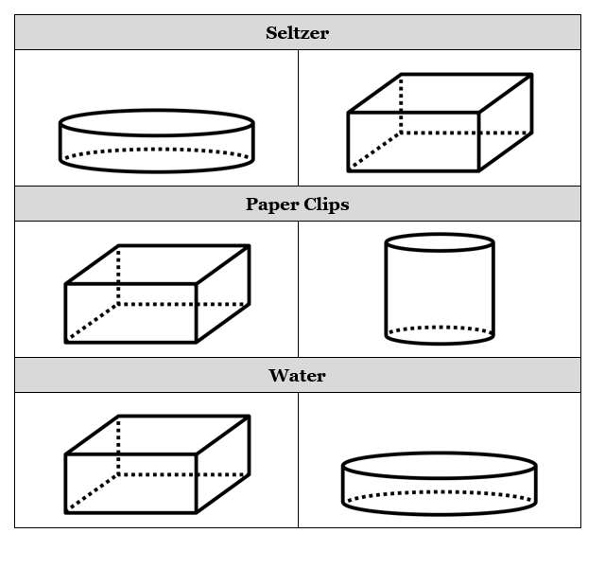
Lesson 6 Activity Guide

Slide 82
Share Observations

Slide 83
What did you notice about the shapes of the liquid samples after you poured each one into a new container?

Slide 84
What did you notice about the shapes of the solid samples in their new containers?

Slide 85
How did a liquid sample look different from a solid sample inside the same kind of container?

Slide 86
Which samples kept their own shapes?

Slide 87
Which samples had shapes like their new containers’ shapes?

Slide 88
Share paper clip observations.

Slide 89
Revisit descriptions of solids and liquids.
Think back on the hummingbird.

Slide 90
How has your understanding of solids and liquids changed?

Slide 91
Class Properties List
Do we have enough evidence to say that liquid samples also have weight?

Slide 92
In what ways are solids and liquids different?

Slide 93
7

Slide 94
Observe the sand.

Slide 95
What do you notice about the sand?

Slide 96
How else could we observe sand to determine whether it is a solid or a liquid?

Slide 97
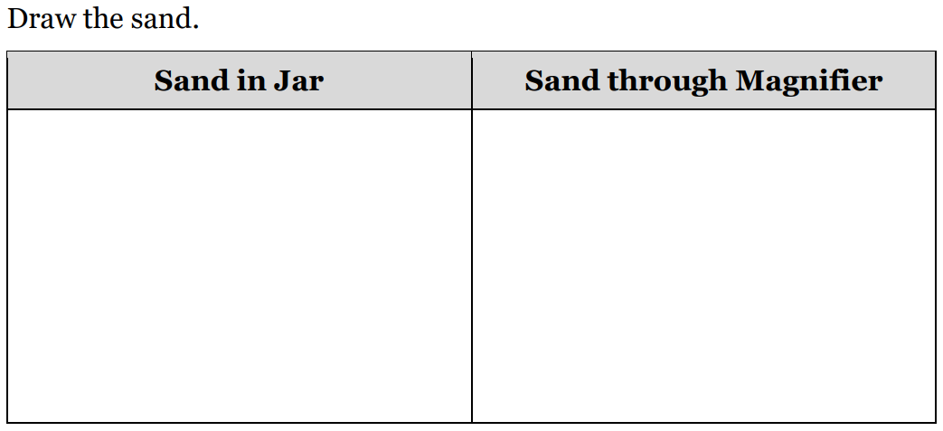
Observe Sand
Lesson 7 Activity Guide

Slide 98
What did you observe about the sand’s properties when you shook the jar?

Slide 99
Lesson 7 Activity Guide

Slide 100
What properties of sand did you observe?

Slide 101
What do the properties you observed
tell you about sand?

Slide 102
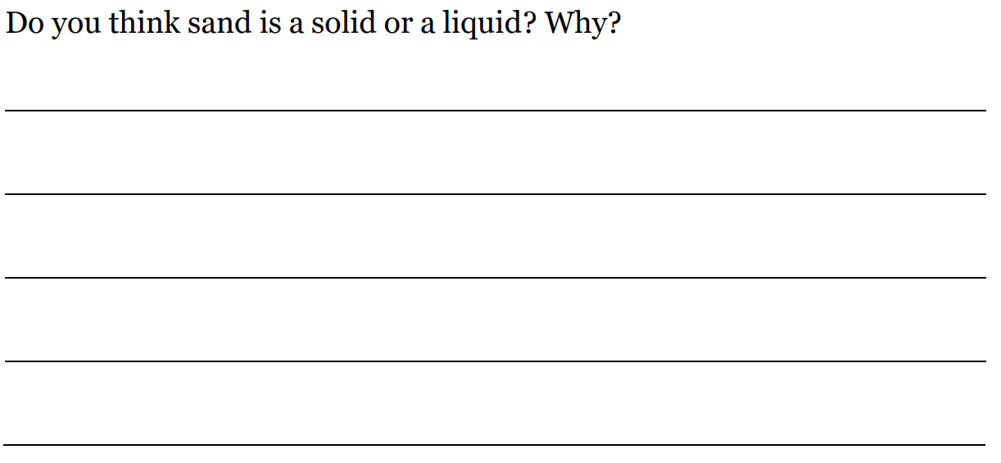
Lesson 7 Activity Guide

Slide 103
In what ways are solids and liquids different?

Slide 104
Update Anchor Chart

Slide 105
A Nest is Noisy, Pages 20–22

Slide 106
Driving Question Board

Slide 107
Look for examples of solids and liquids in your home or community. Record examples you find in a notebook, or share them with someone at home.
Homework

