Slide 1


Slide 2
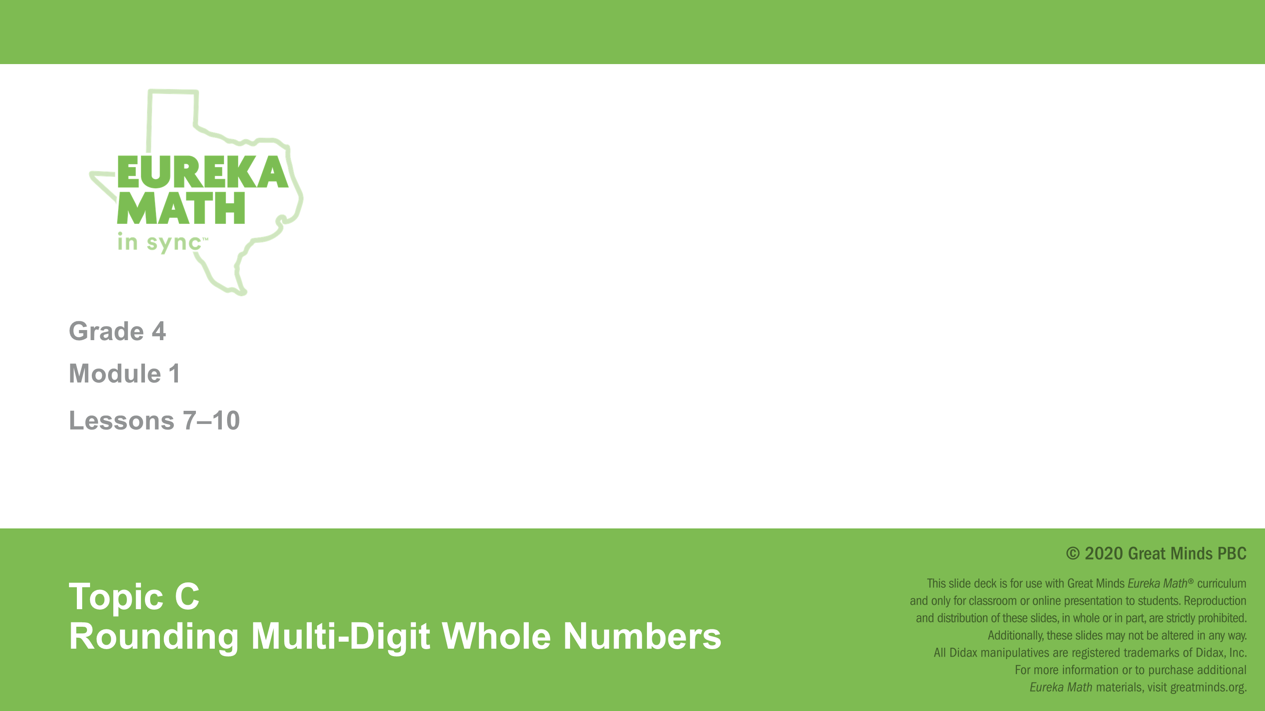

Slide 3
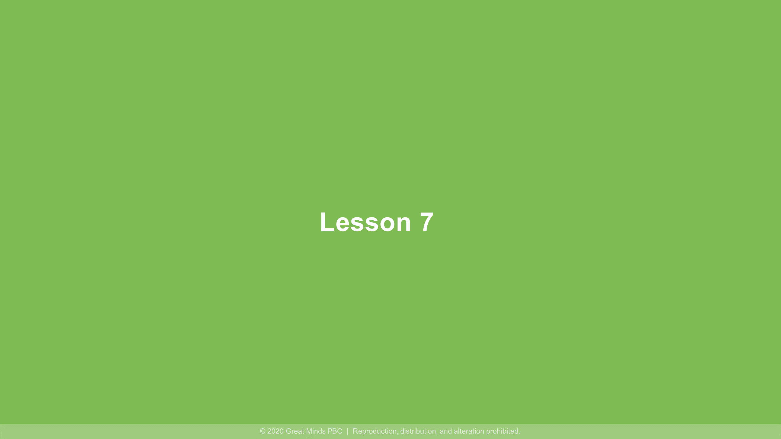

Slide 4
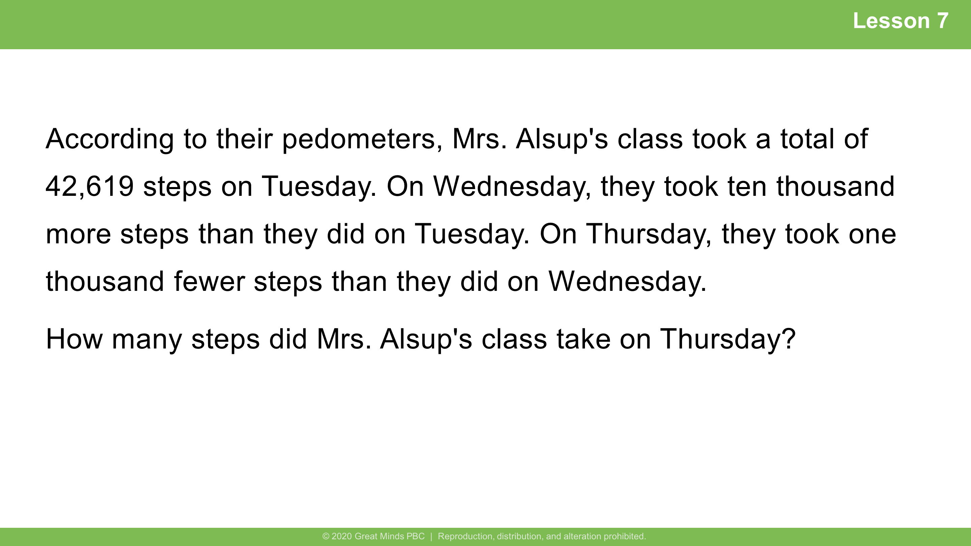
Notes:
Lesson 7
​
6 minutes
​
Guided Practice
​
Note: This Application Problem builds on the concept of the previous lesson requiring students to find 1 thousand, 10 thousand, or 100 thousand more or less than a given number.
​

Slide 5
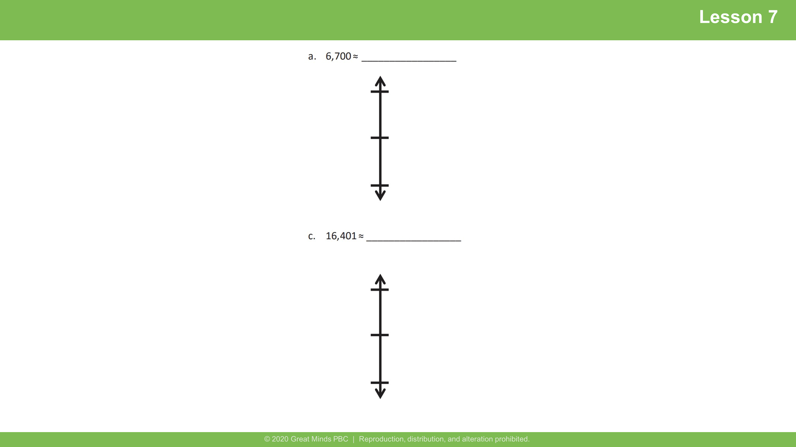
Notes:
Lesson 7
Student Debrief: Connection
​
Look at Problem 1(a) and 1(c) in the Problem Set. Compare how you rounded 6,700 and 16,401. Explain how your rounding to the nearest thousand differed even though both numbers have a 6 in the thousands place.

Slide 6


Slide 7
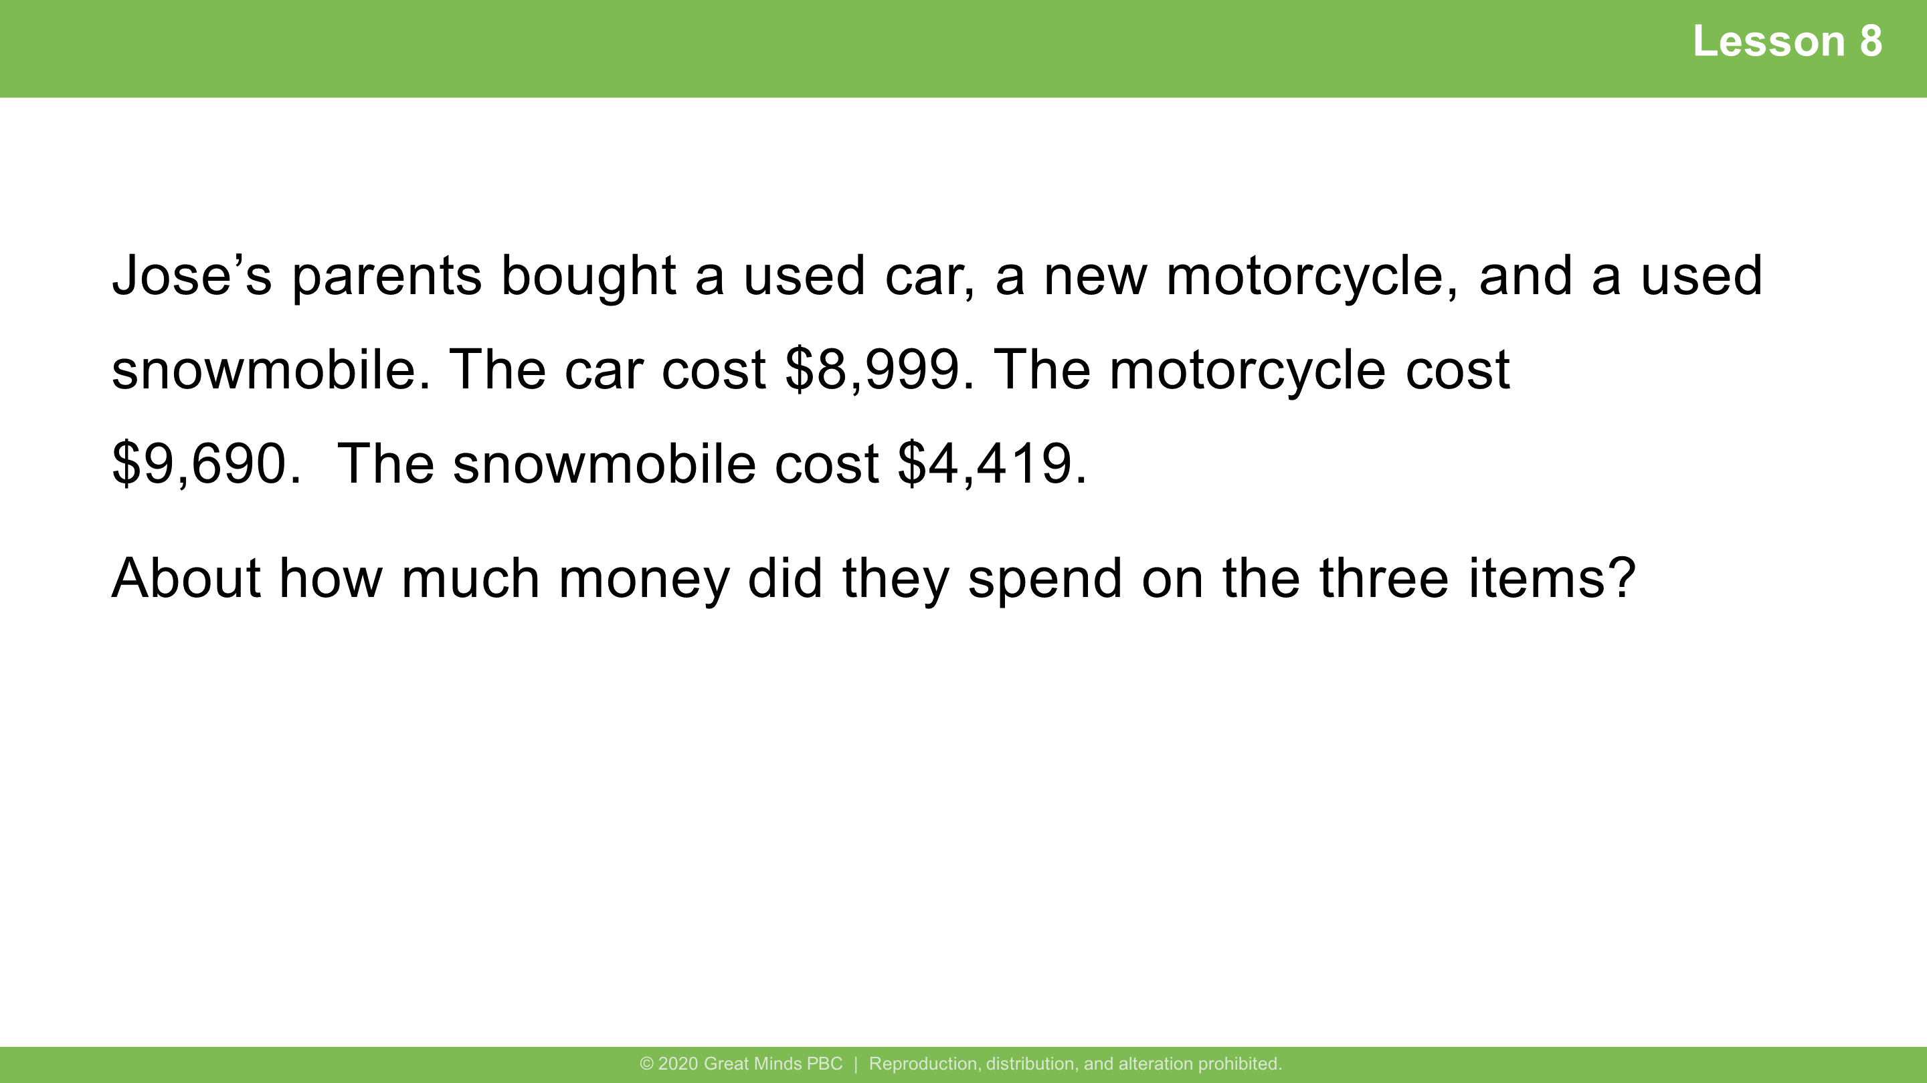
Notes:
Lesson 8
​
6 minutes
​
Guided Practice
​
Note: This Application Problem builds on the content of previous lessons. Students are required to round and then to add base thousand units.
​

Slide 8
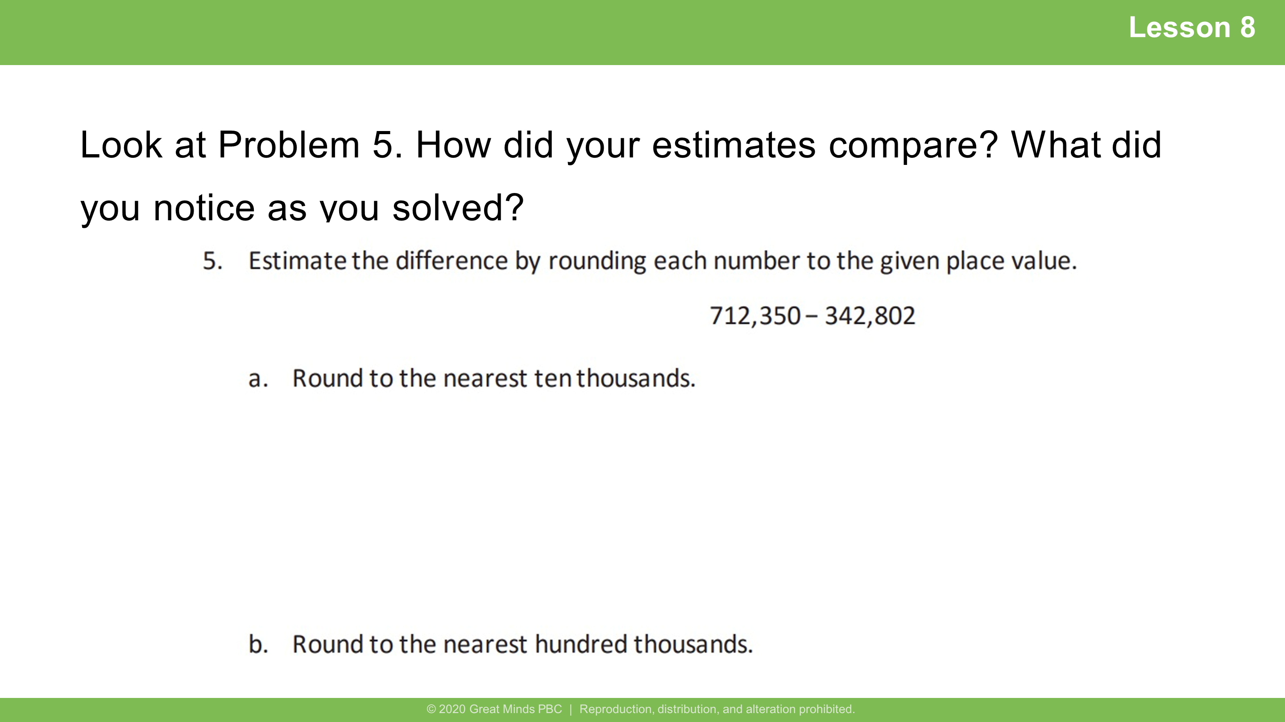
Notes:
Lesson 8
Student Debrief: Connection​
Students may provide the answers such as:
a. 370,000
b. 400,000
Encourage students to discuss that the answer for letter a is also rounded to the nearest ten thousands and the answer for letter b is also rounded to the nearest thousands.

Slide 9


Slide 10
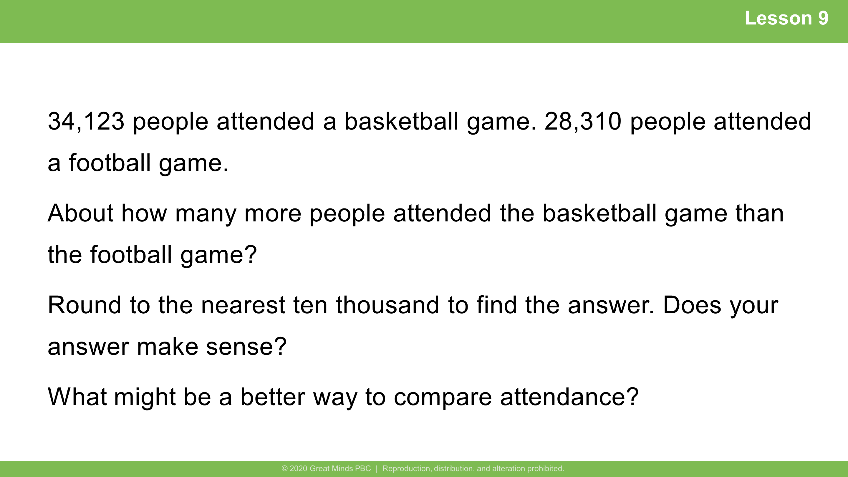
Notes:
Lesson 9
​
8 minutes
​
Guided Practice
​
Note: The Application Problem builds on the concept learned in the previous lesson. Students are required to round and then to subtract using base thousand units. Students have not practiced an algorithm for subtracting with five digits. Due to the rounded numbers, you may show subtraction using unit form as an alternative method (34 thousand – 28 thousand, instead of 34,000 – 28,000).
​

Slide 11
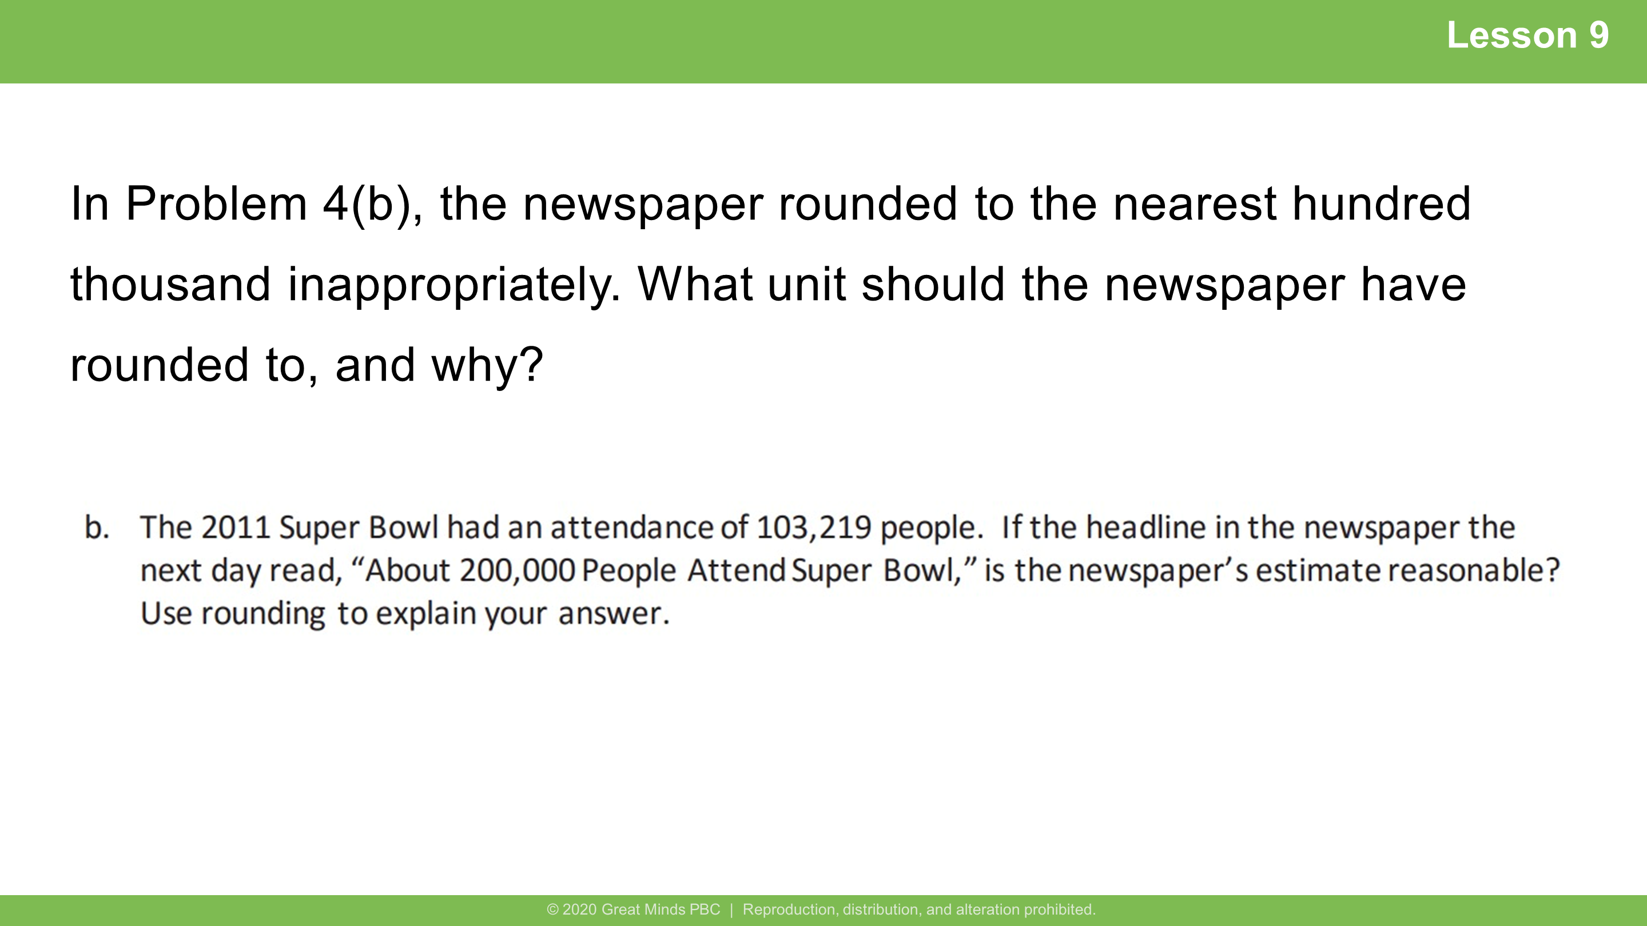
Notes:
Lesson 9
​
Student Debrief: Error Analysis
Students may say that the number was rounded incorrectly.
Encourage them to elaborate as to why or how they know that.
What unit should the newspaper have rounded to, and why?
Hundred thousands place – it is an estimate of how many people attended.
Thousands place – it is a more accurate estimate of how many people attended.
Whichever unit the students choose encourage them to elaborate why they chose that particular unit.

Slide 12
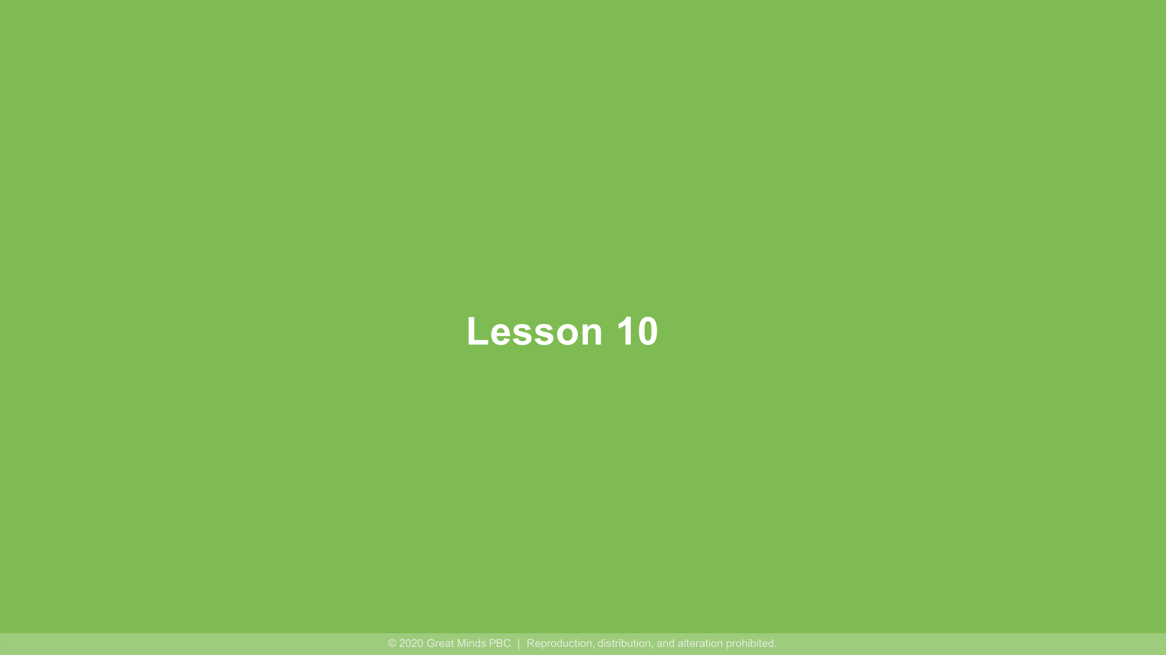

Slide 13
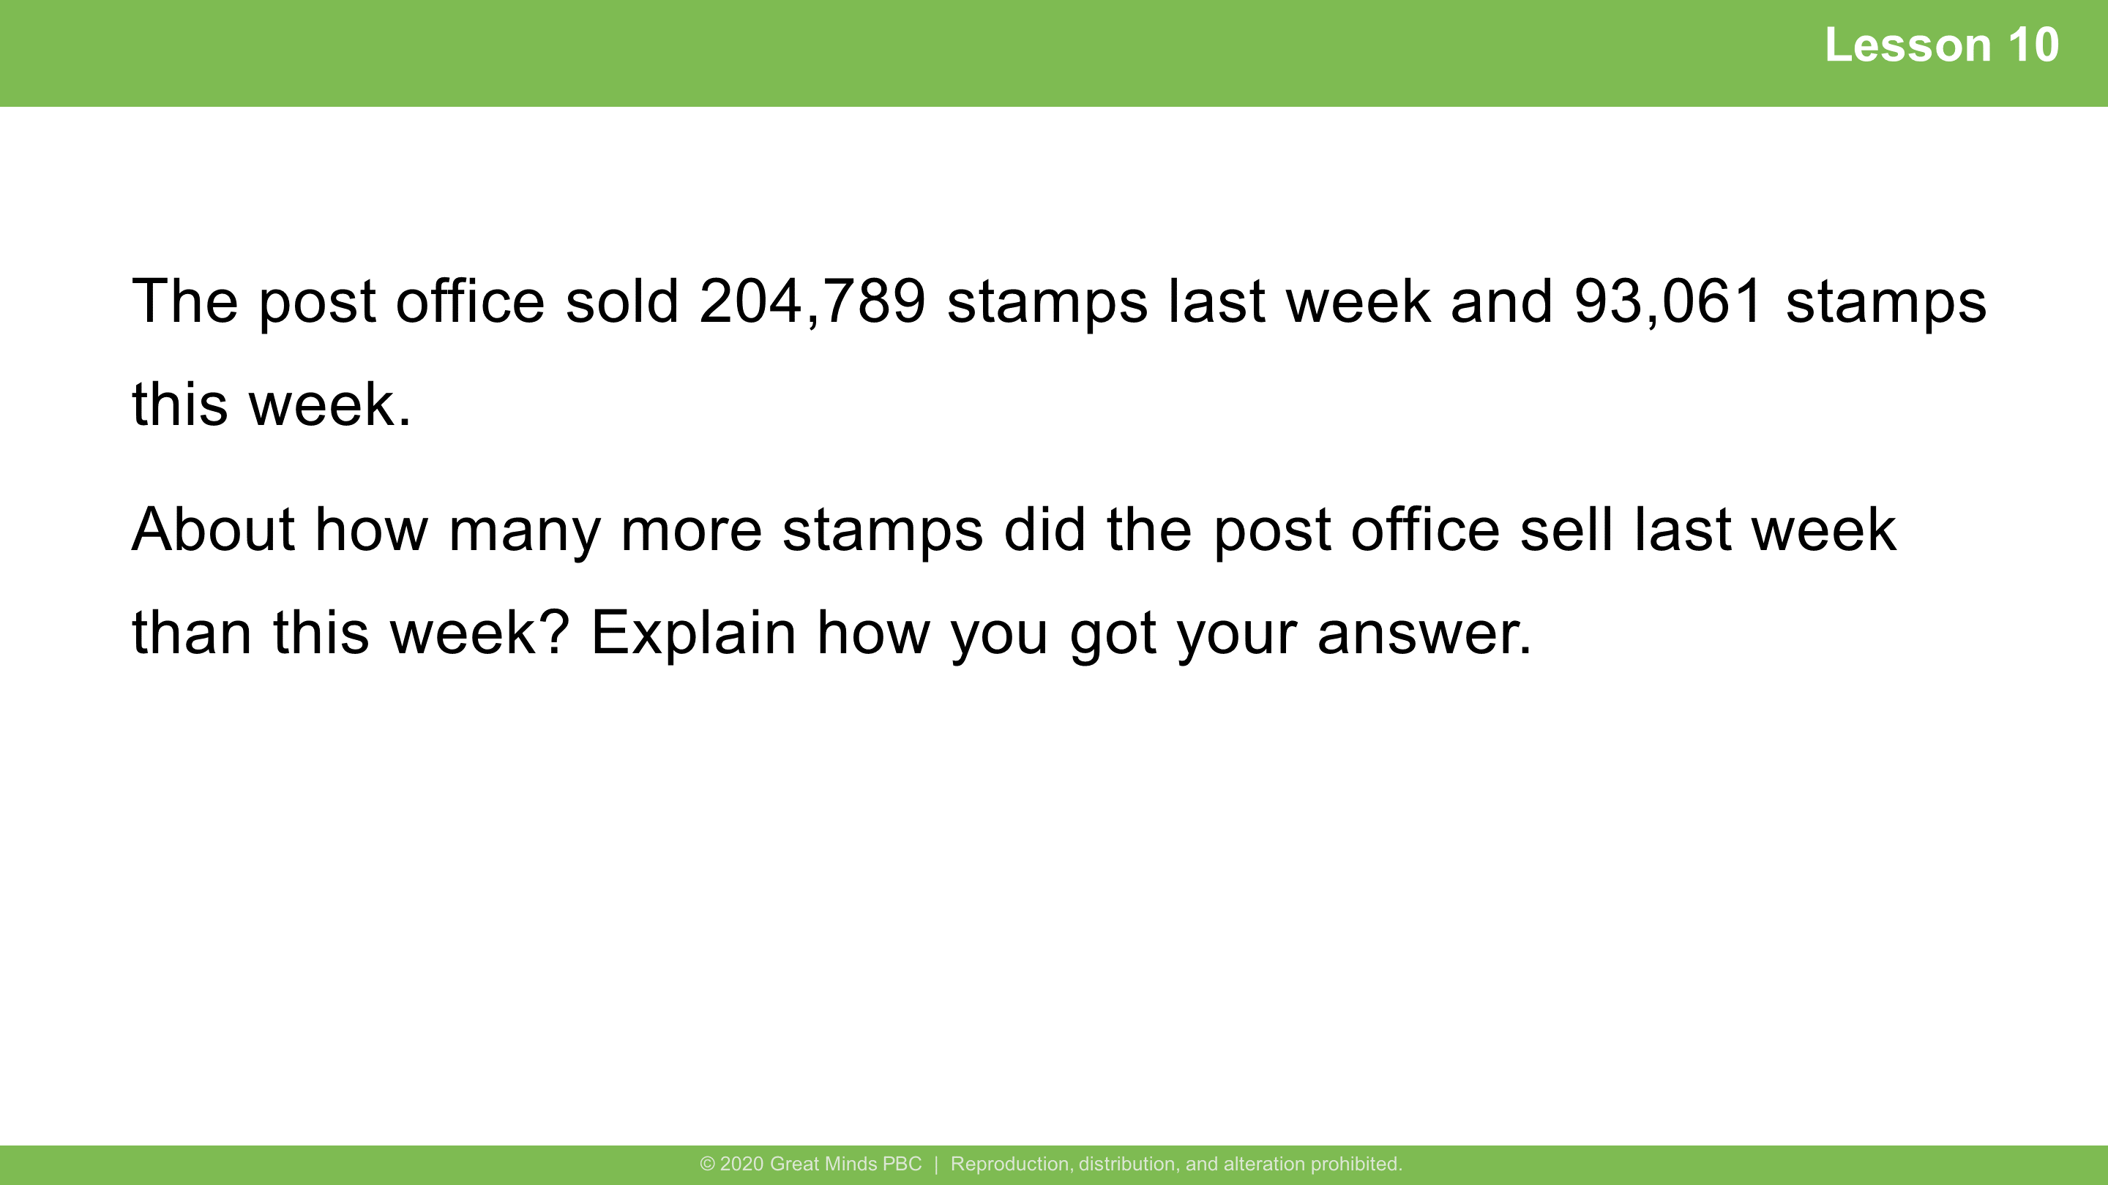
Notes:
Lesson 10
​
6 minutes
​Independent Practice
​Note: This Application Problem builds on the concept of the previous lesson (rounding multi-digit numbers to any place value) and creates a bridge to this lesson’s concept (rounding using real world applications).
​

Slide 14
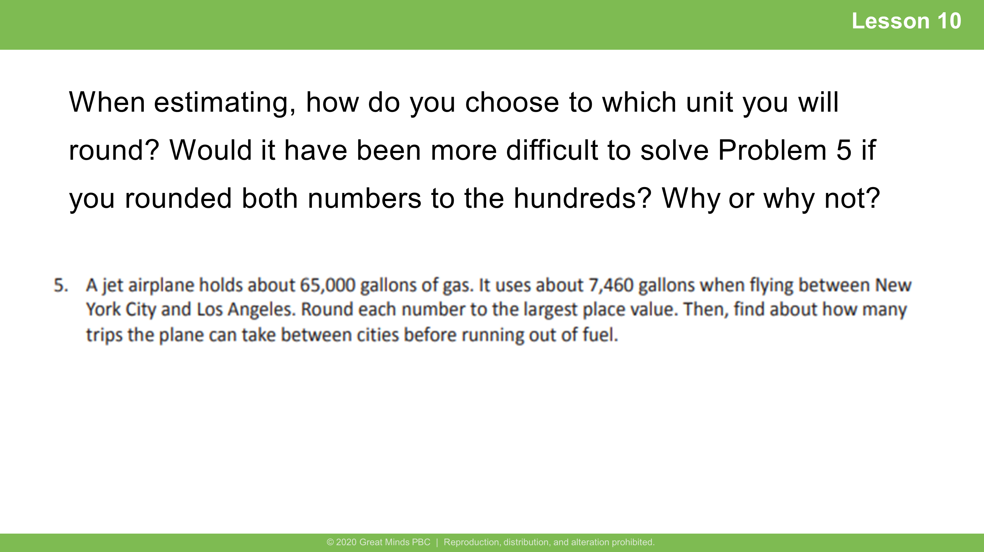
Notes:
Lesson 10
​
Student Debrief: Impact
When estimating, how do you choose to which unit you will round?
Encourage various students to share their methods with the class.
Would it have been more difficult to solve Problem 5 if you rounded both numbers to the hundreds?
Why or why not?
Students may say that either way you can only make 8 trips.

Slide 15


Slide 16
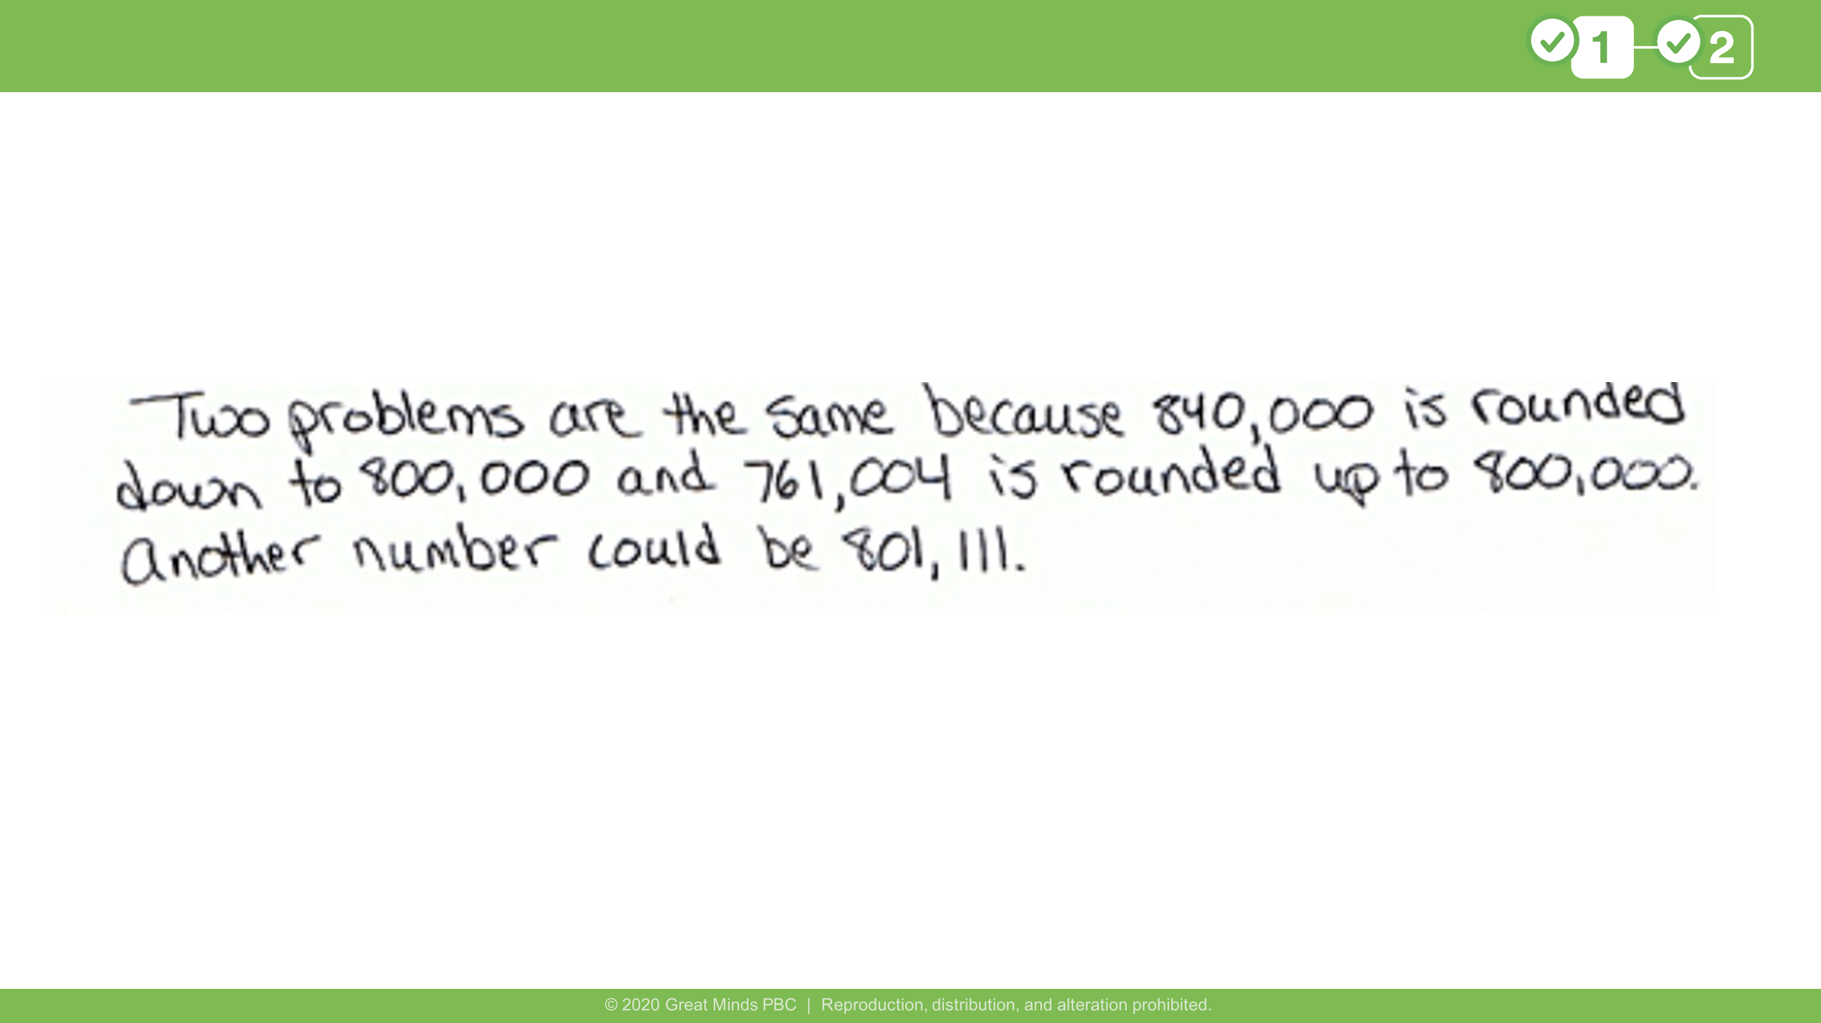
Notes:
This comes from Lesson 9 Problem Set Problem 3(e).
MATH CHAT
​
In Problem 3(e), you and your partner probably wrote different numbers that rounded to 800,000. Explain why your numbers were different.
Our numbers were different because there are lots of numbers that would round to 800,000.
What is the smallest possible number that could round to 800,000 when rounded to the nearest hundred thousand? Explain your reasoning.
750,000; 749,999, which is 1 less than 750,000, would round down to 700,000
What is the largest possible number that could round to 800,000 when rounded to the nearest hundred thousand? Explain your reasoning.
849,999; 850,000, which is 1 more than 849,999, would round up to 900,000
​
​

Slide 17
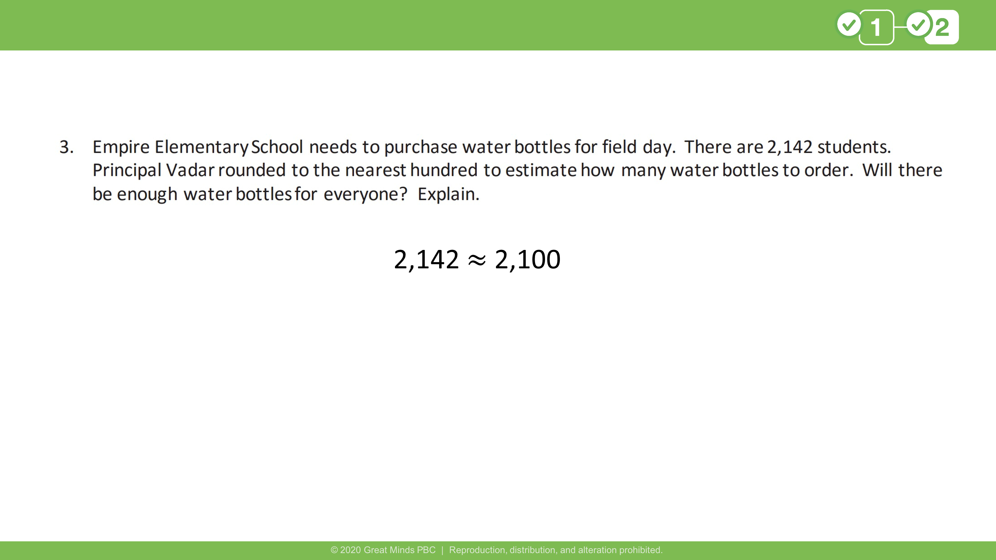
Notes:
This comes from Lesson 10 Problem Set Problem 3.
MATH CHAT
In Problem 3, why didn't rounding to the nearest hundred work?
It didn’t work because there wouldn’t be enough water bottles for everyone if we rounded to the nearest hundred.
Would rounding to the nearest thousand have worked better?
Rounding to the nearest thousand also would not have worked because there still wouldn’t be enough water bottles for everyone.
What does this show you about rounding?
We need to consider the situation and what makes sense in that situation when deciding how to round in real-world scenarios. Sometimes we might not follow the “rules” of rounding in real life because it wouldn’t make sense in that situation.
​
​

Slide 18


